Slide 1
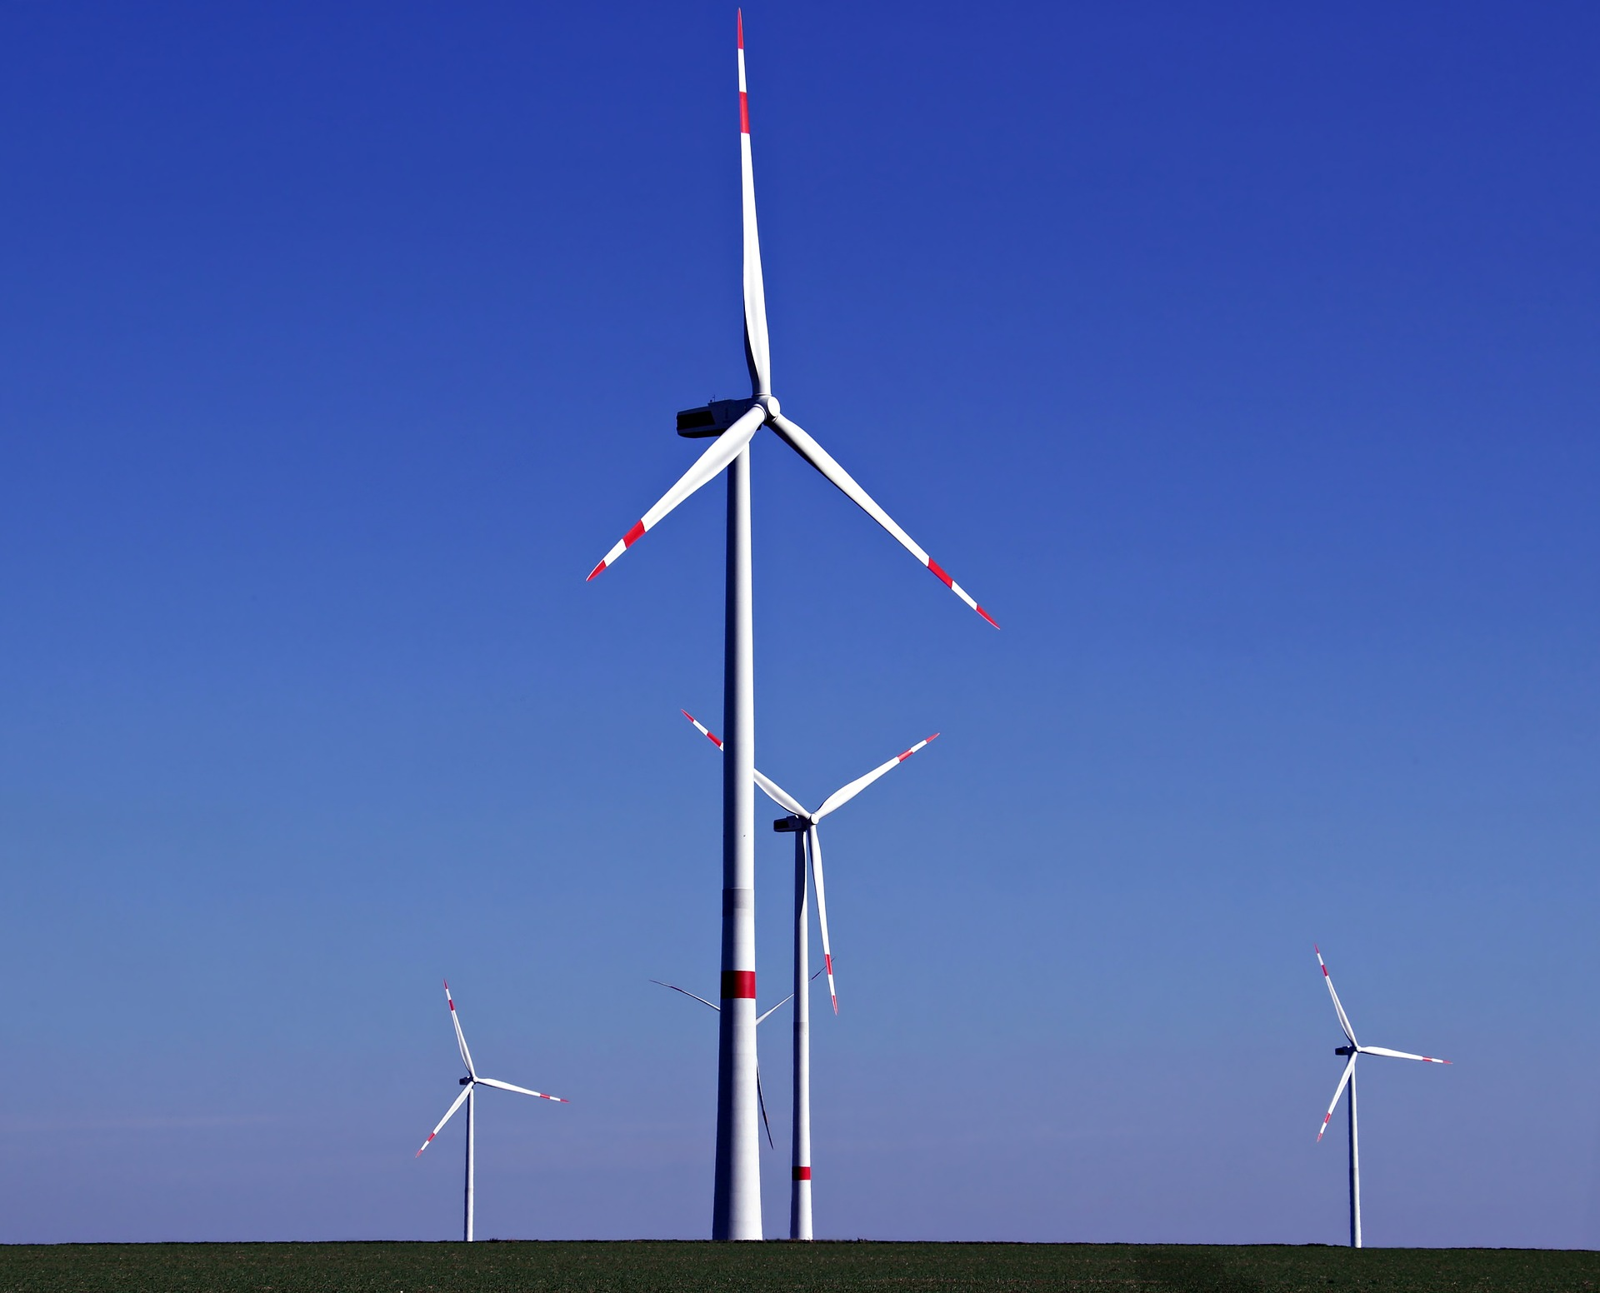
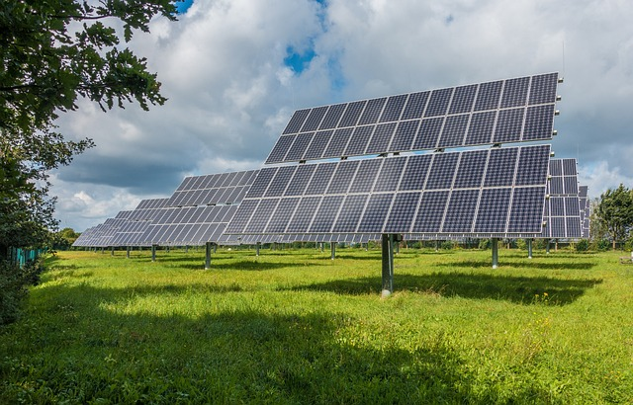
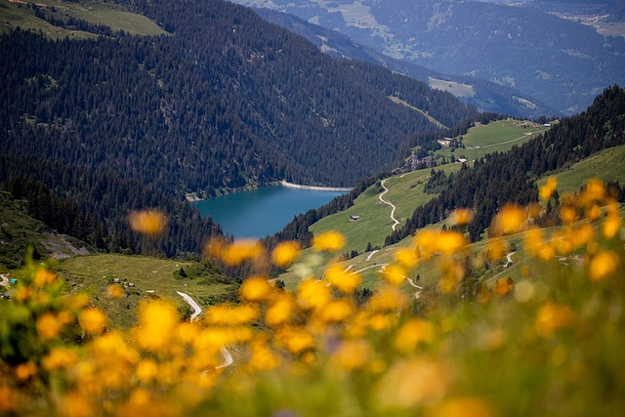
Which will be the odd one out in the future? Explain why
Images © Pixabay, Adobe Stock Images

Slide 2
What Jobs will be available in the Offshore Wind industry in
NE England ?
Image © Adobe Stock Images

Slide 3
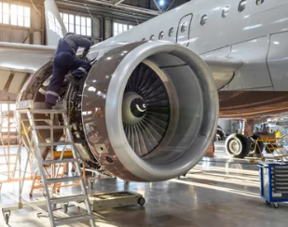
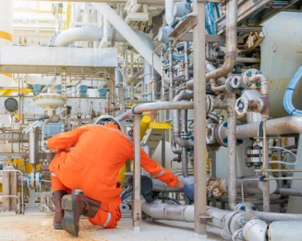
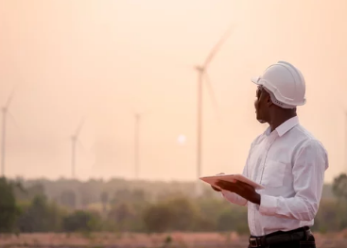
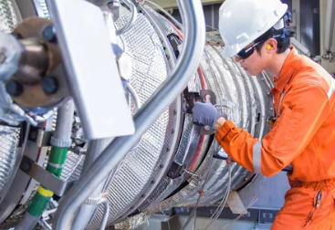
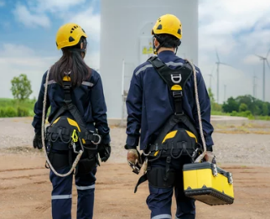
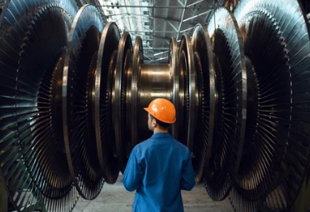
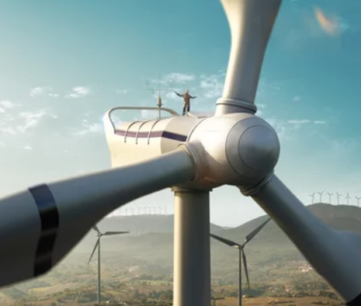
Images © Adobe Stock Images

Slide 4
Image © Adobe Stock Images

Slide 5
Image © Adobe Stock Images

Slide 6
Image © Adobe Stock Images

Slide 7
Image © Adobe Stock Images

Slide 8
Image © Adobe Stock Images

Slide 9
Image © Adobe Stock Images

Slide 10
Image © Adobe Stock Images

Slide 11
Image © Adobe Stock Images

Slide 12
Image © Adobe Stock Images

Slide 13
Image © Adobe Stock Images

Slide 14
Image © Adobe Stock Images

Slide 15
Using your diagram, identify as many jobs as you can associated with the construction of offshore wind turbines.
Image © Adobe Stock Images

Slide 24
Senior Electrical Engineer (HV)
Location: Hull
Salary:£50000 - £60000 per annum + Package
Siemens develop, build and operate offshore wind farms along the coasts. Their extensive project pipeline includes wind farms totalling over 4GW.
Your Profile
University degree or equivalent education in electrical power system engineering - Experience in project management for energy, wind or gas and oil industry projects preferable - Excellent analytical and conceptual skills, able to drive innovative and strategic thinking - Excellent communication skills, able to communicate effectively within a multicultural project team - Self-organized and independent working - Good level of English verbal / written - Strong co-ordination and leadership skills - Willing to travel frequently

Slide 26
Leave school at 16 with GCSEs…..
Apprenticeship with a wind energy company in engineering, food, electrical skills….. Working and studying for NVQs
Working in low-skill on-shore jobs producing and packing supplies for offshore, laundry, etc.
Leave school at 18 with A levels…..
Apprenticeship in engineering, food, electrical skills, accountancy
Working in onshore base in supplies, publicity, accounts, education, public relations
Leave University with a degree……
Work in onshore and offshore careers in designing, planning, constructing, maintaining and researching .
Chance to travel and work in different parts of the UK, Europe & the world

Slide 27
Wind Turbine Jobs
Mechanical engineer,
Senior structural engineer
Power system engineer
Senior electrical engineer
Project manager onshore
Wind turbine service technician
Offshore wind turbine technician
Wind loading engineer
Rank jobs in order of skills and qualifications needed

Slide 28
Task : Your job is to attract people in the East Yorkshire area to come to a ‘Careers in Wind Energy’ day at Hull University, where they can learn about the whole range of jobs that will need filling.
Produce a poster that will attract lots of different people showing them the range of exciting jobs in the wind industry
Images © Adobe Stock Images

