Slide 1
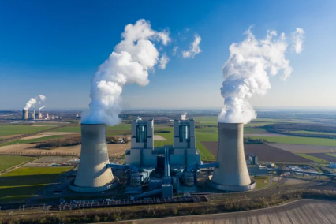
Drax Power Station - Against
Drax Power station is the largest generating facility in the UK, and its main fuel is coal. The power station produces about 15% of the electricity used in the UK, but in so doing it gives out a large amount of CO2. However Drax is trying hard to reduce its CO2 emissions. It currently uses a mix of biomass from renewable sources with coal. This means it was able to reduce overall CO2 emissions by more than 1.5million tons last year by producing 11.2% of its power by mixing bio-mass with the coal.
In addition to this there is also the major advantage that the new bio-mass generation will make sure that people stay employed and there could even be new jobs at the existing power stations like Drax and Eggborough if more biomass is used there. Coal is still a big part of our future!
© Adobe Stock Images
http://www.draxgroup.plc.uk/corporate_responsibility/environment/fuels/

Slide 2
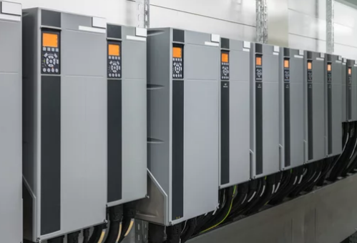
Industrial Energy User - Against
Industry is big money we need to make sure that we have a constant supply of electricity to run our business, any cuts or changes in the flow of power can be disastrous. We also need to have a supply that can cope with surges in demand. 350 turbines, each over 400 feet high produce 220MW of power (about 10% of what a coal fired power station can produce). Even then they would not generate any power at all when the wind was below 9 miles per hour. The turbines would have to be used with the power stations not instead of them because the power stations would still be needed to generate the power when there was no wind. It is simply not a reliable enough option for us.
© Adobe Stock Images
© Adobe Stock Images

Slide 3
Taxpayer’s Together Against
(Similar group to research)
At present the 400 turbines across North Yorkshire receive £100 million per year in subsidy which is paid by electricity consumers. ( Roughly £160 per year per person living in North Yorkshire). This is a completely ridiculous amount! Building more turbines off shore or onshore is just not an option for us! This level of subsidy for power that might be produced at times when it is not actually needed is totally unreasonable and irresponsible.
We think that the amount of subsidy paid should take into account the ability of a renewable energy source to produce power as and when required. Power produced by wind turbines at 2 am when it is not required should not be worth as much as power produced at 6.30pm when the demand for power is at the highest levels. All we ask is that the Government looks at things in a sensible way. Are wind farms the answer if they need so many subsidies. Surely investing this money in alternative renewable energy methods is the answer.
http://www.stopwoodlanewindfarm.co.uk/news42pmqsubsidylevel.htm

Slide 4
Whale & Dolphin Preservation Group - Against
Noise is always produced throughout the development of building offshore turbines. This means that during construction, operational and decommissioning phases there will be noise, there is also noise from ship traffic going to and from the site. Pile-driving is a particularly intense noise and can disrupt the behaviour of marine mammals that are many kilometres away. Research has shown that their hearing can even be damaged if they go nearer.
Other research has reported the reaction of porpoises to the construction of offshore wind farms by monitoring their echolocation clicks, they found changes in habitat use, with the porpoises leaving the construction area. There are many possible other effects too including; disturbances to the food chain if fish are scared away, destruction of habitats, and the constant vibrations from the turbines themselves once built. This is a nightmare situation for the marine animals and their habitat.
(Similar group to research)
http://www.wdcs.org/submissions_bin/wind_farm_workshop.pdf

Slide 5
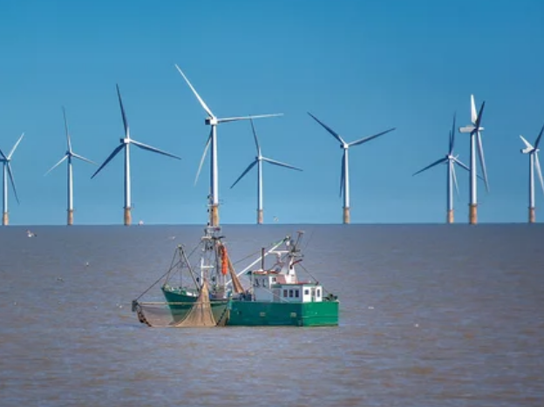
Fishermen- Against
In Holderness in Yorkshire consent has recently been given to Danish company Dong Energy for the construction of a 35 square km wind farm at Westermost Rough, one of the most important parts of the Holderness Coast fishery. The rocky area has plenty of small boulders and crevices which provides a near-perfect, but highly sensitive habitat for lobsters. This habitat faces complete destruction, while Holderness fishermen will only be able to fish the area with permission from Danish company, Dong Energy.
Albert Rosser local fisherman says ‘To see the areas they and their ancestors have fished for centuries sold to foreign energy companies, will be too much for many of my fishermen friends to bear.’ The government simply haven't thought this through. Why are they going to ruin areas that have been fished for hundreds of years in order to build wind turbines that will last 20 years at a push? Why are they going to ruin the fragile village fishing industries of the East coast, which provide money to the local economies in pursuit of a technology that is unreliable and inefficient?”
© Adobe Stock Images
http://www.yorkshirepost.co.uk/news/features/storm_over_heritage_hidden_beneath_the_waves_that_reveals_a_deep_divide_1_3735198

