Slide 1
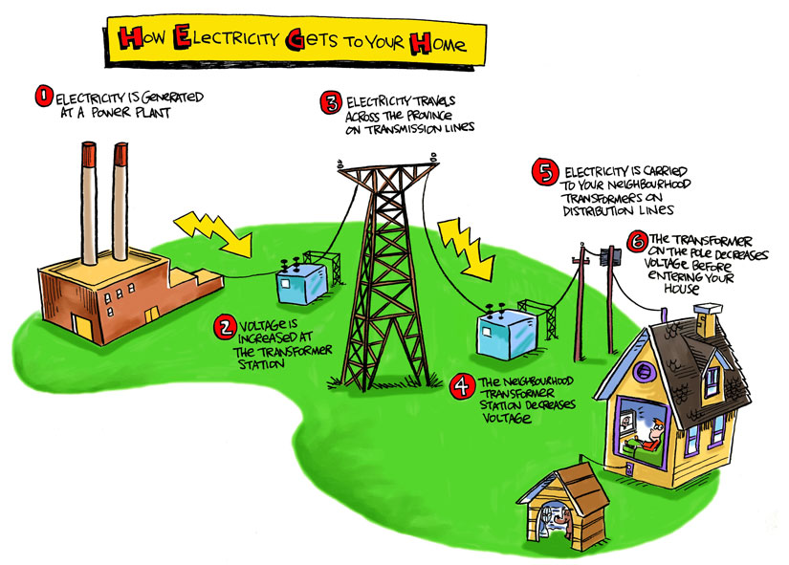
But what’s the best
Way to make it ???

Slide 2
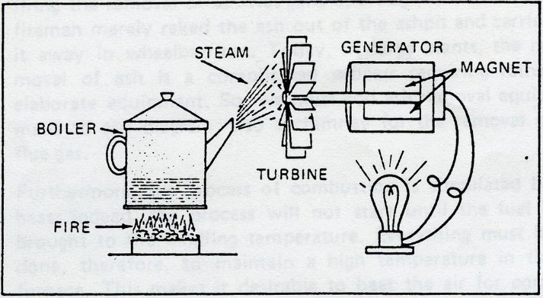
Thermal fuels
Use the fuel to turn WATER to STEAM which drives a TURBINE which GENERATES electricity
Coal
Oil
Gas
Nuclear
Wood
Biomass (some)
Solar (some)
Primary Energy : When energy is extracted from a fuel source directly e.g burning oil, coal, gas, wood…and using the heat directly, or getting energy from the sun, or using wind to turn a grinding wheel in a traditional windmill.
Secondary Energy: Sometimes primary fuels are converted into a different form of energy – which is more versatile, the best known being ELECTRICITY. It’s a type of energy that is made from transforming a ‘primary’ energy fuel into a different energy.

Slide 3
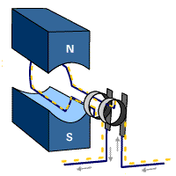
Making Electricity is easy. You just need to spin a magnet inside a coil of wire, or spin a coil of wire between a N and S magnet.

Slide 4
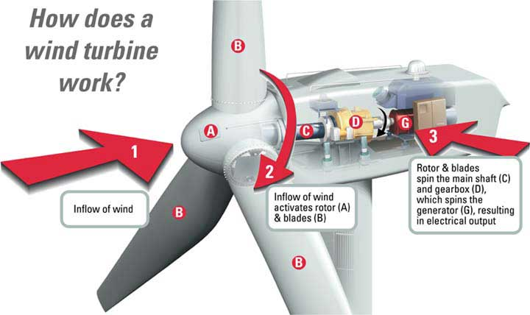
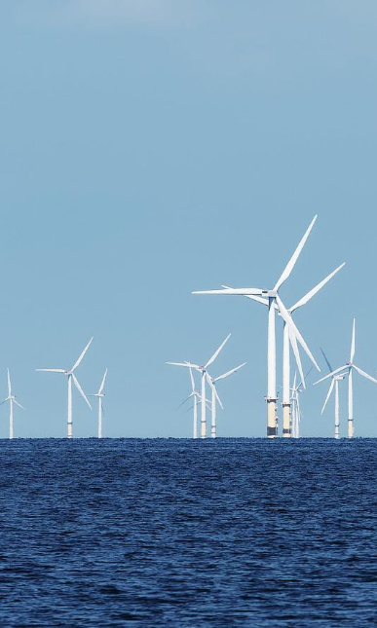
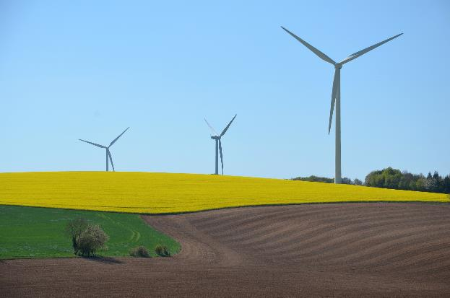
Wind Power:
An easy way to spin the magnet inside the coil
© Pixabay 2022
© Pixabay 2022

Slide 5
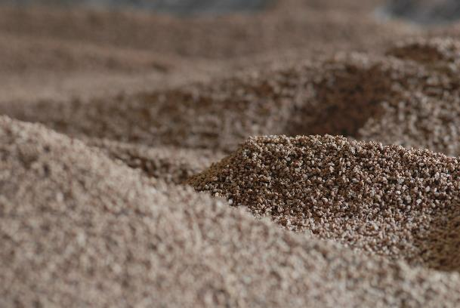
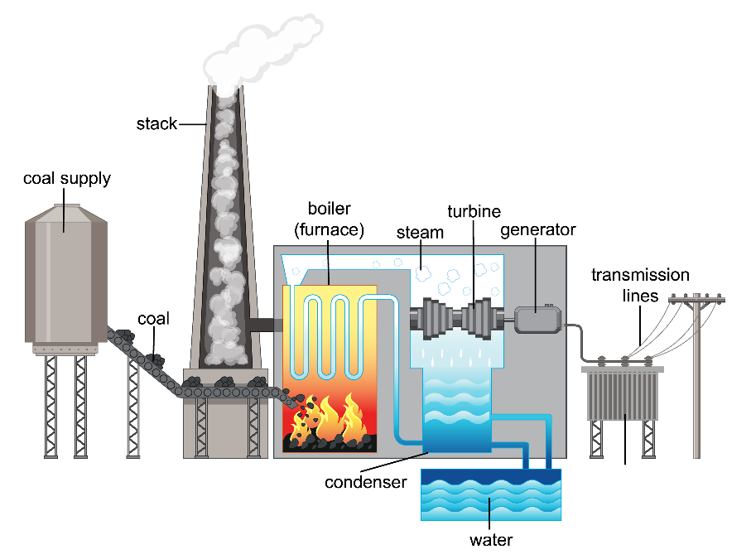
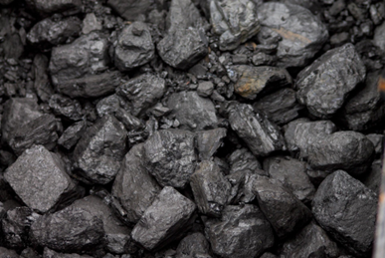
In a coal or biomass -fired power station:
Fuel is burned – to turn water to steam…...steam expands and is directed onto blades of a turbine (giant fan) …..Which spins a magnet inside a coil of wire
In other power stations the fuel is gas instead of coal or biomass.
© Pixabay 2022
© Pixabay 2022
© Adobe images 2022 419266787 stock.adobe.com

Slide 6
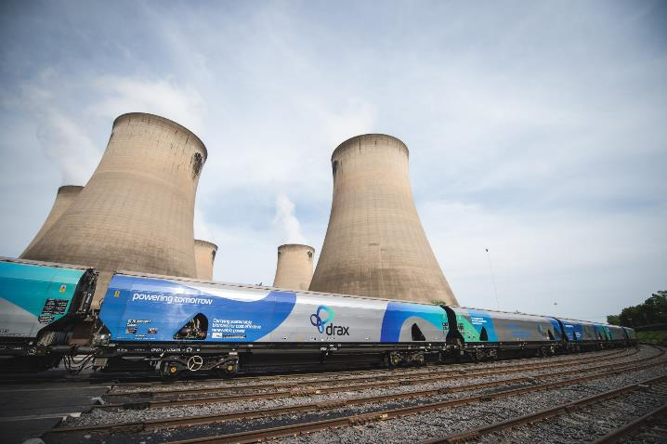
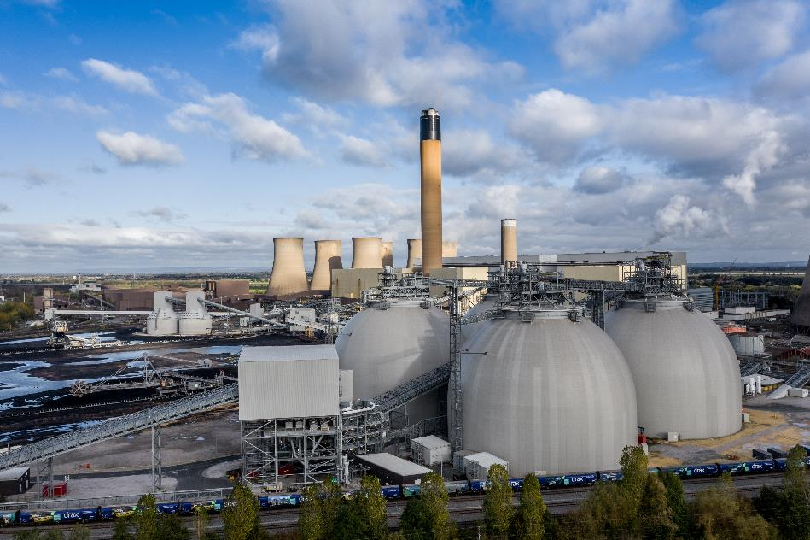
From Coal to biomass – fired Power Station : Drax, Yorkshire.
Image Source :https://www.drax.com/power-generation/drax-rail-history/
© Adobe images 2022 469498574stock.adobe.com

Slide 7
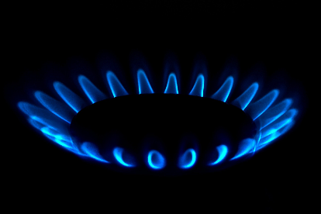
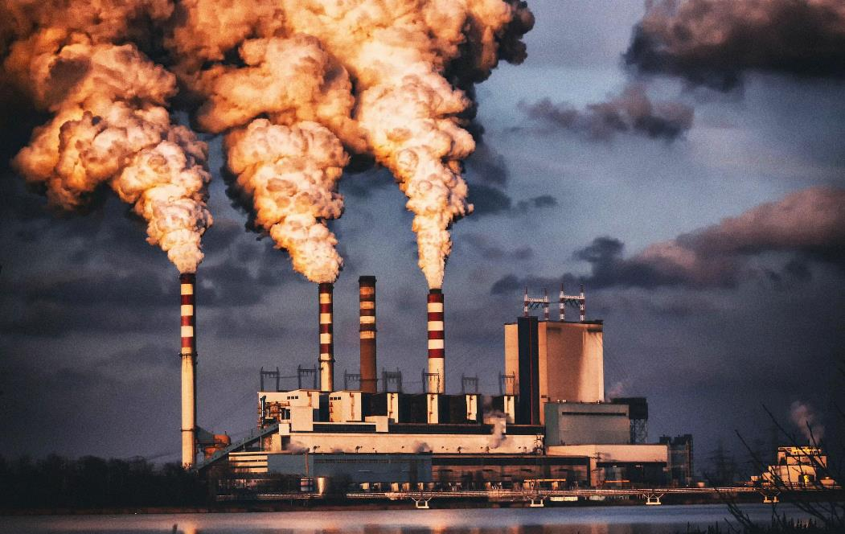
Gas – fired Power Station
Images © Pixabay 2022

Slide 8
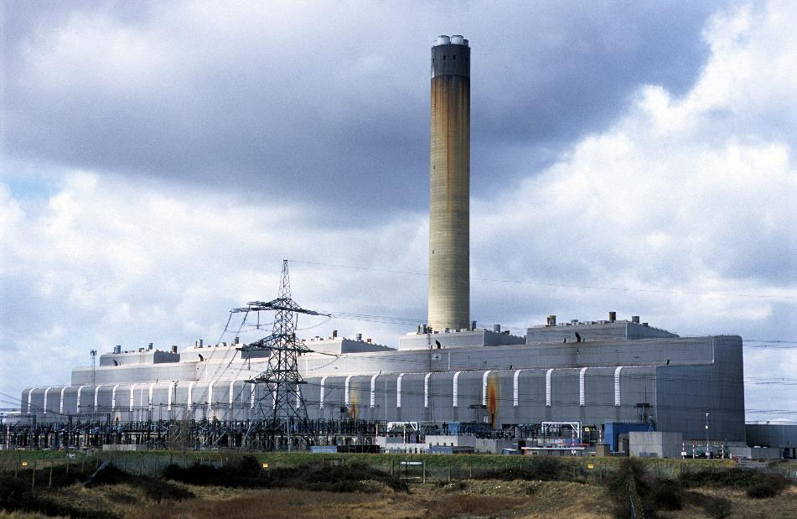
Oil – fired Power Station : Isle of Grain, Rochester
© Pixabay 2022
Image source: Clynt Garnham Energy / Alamy Stock Photo

Slide 9
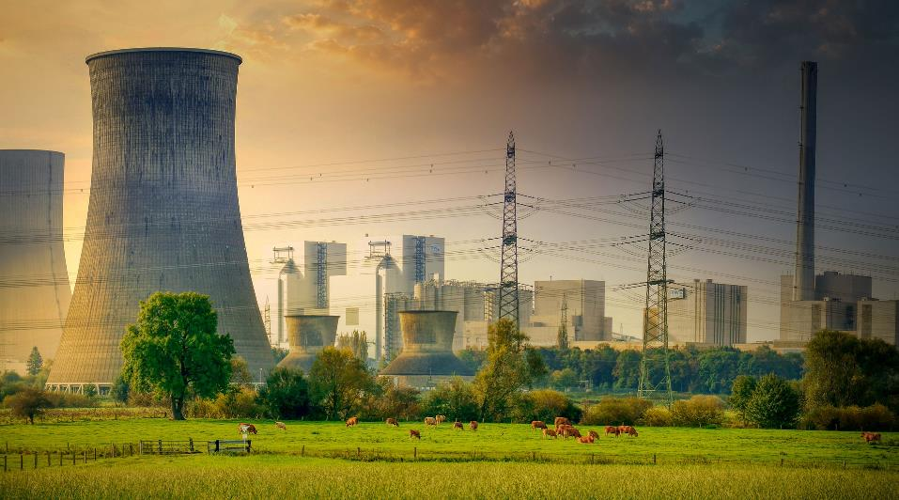
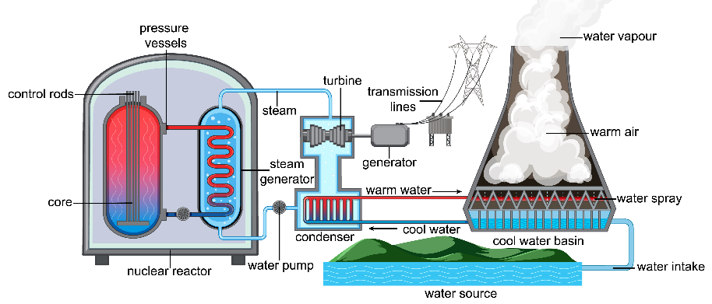
Nuclear Power Station
© Pixabay 2022
© Adobe images 2022 419266405 stock.adobe.com

Slide 10
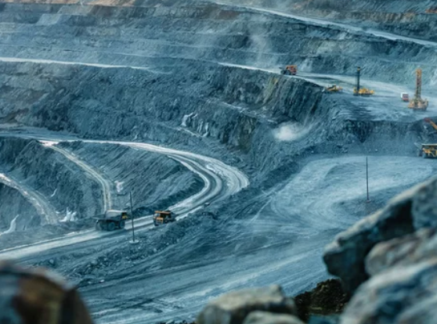
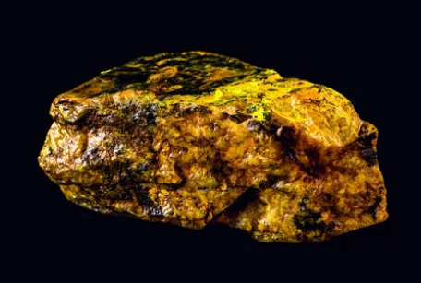
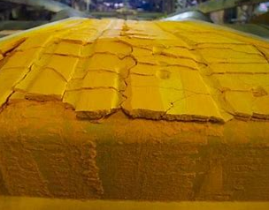
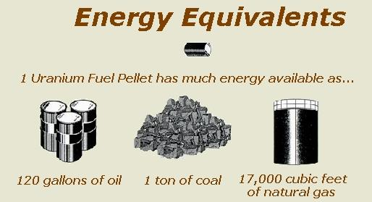
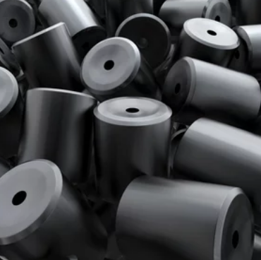
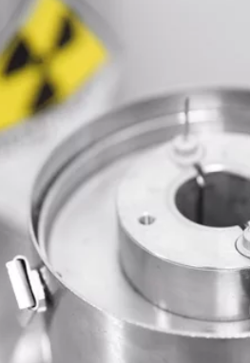
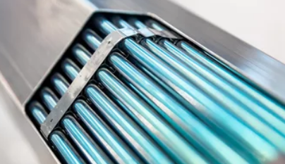
A Uranium mine…
…gives uranium ore….
…..Which is processed into uranium ‘cake’…
…and then made into a pellet…
…stacks are put together into a fuel cask. Now enough uranium concentrated to give ‘radiation’ heat.
..rods are put into a fuel stack
…pellets are stacked to make a rod…
Images © Adobe Stock

Slide 11
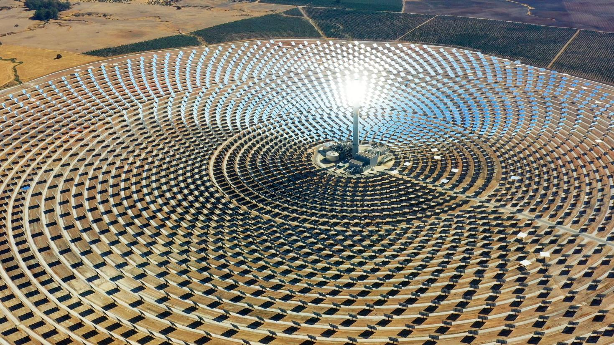
Solar Power
Reflective thermal
© Adobe images 2022 290877534 stock.adobe.com

Slide 12
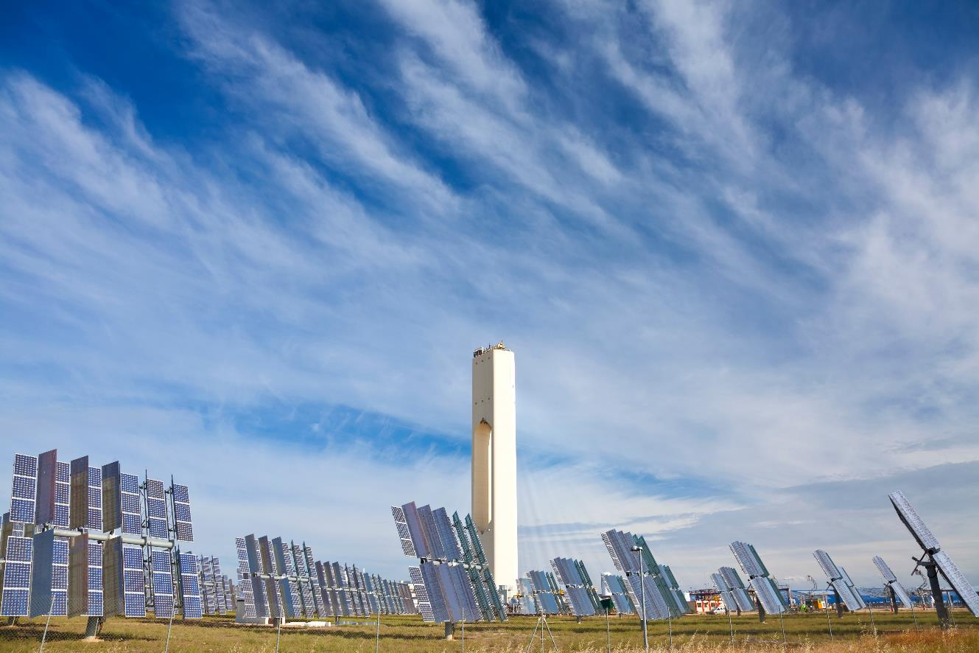
Massive solar array at Seville in S. Spain – Europe’s first commercial solar power plant of its type
© Adobe images 2022 23674429 stock.adobe.com

Slide 13
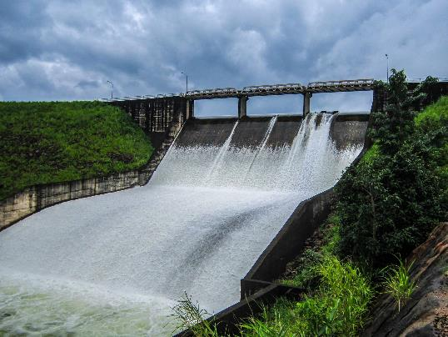
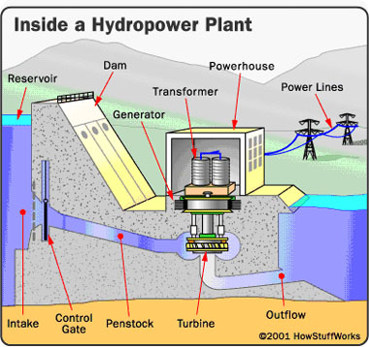
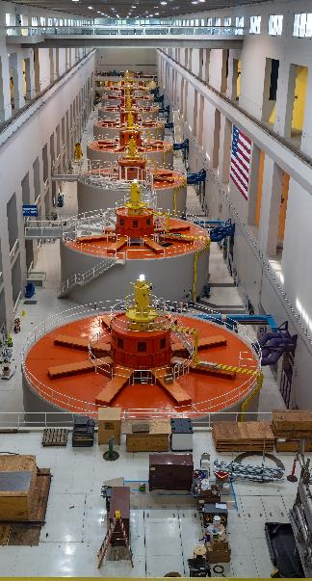
Hydro Electric Power (HEP)
© Adobe images 2022 309126418 stock.adobe.com

Slide 14
Wind Power
© Pixabay 2022
© Pixabay 2022

Slide 15
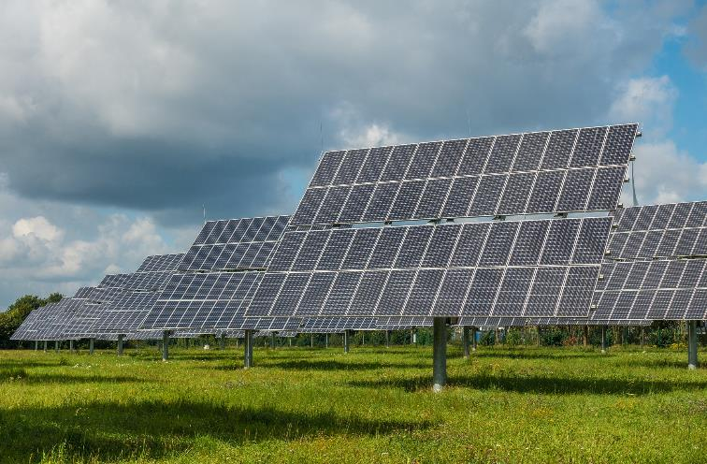
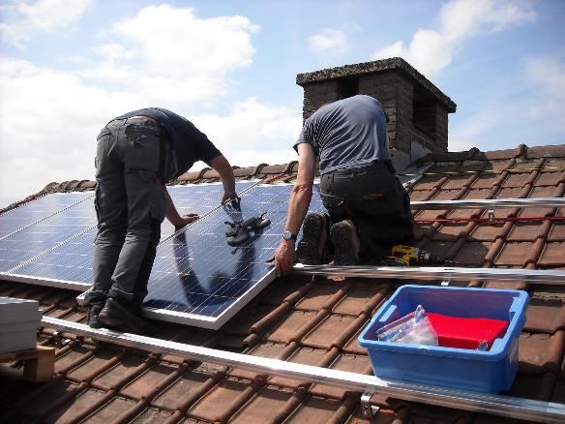
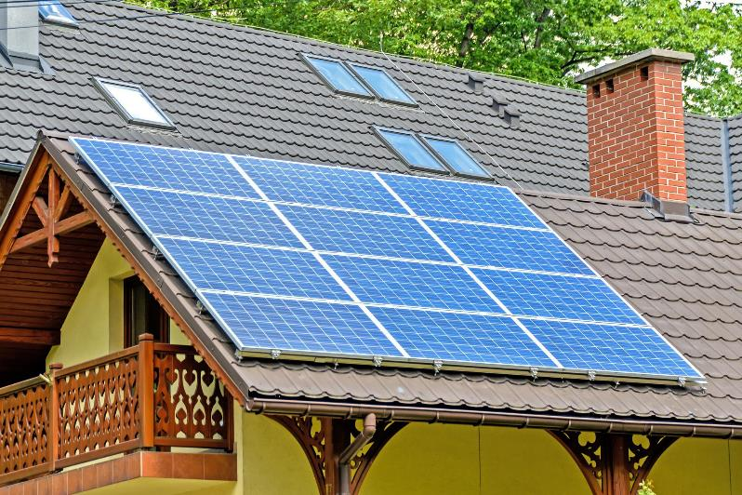
Produce direct Energy
Solar : Photovoltaic Cells
Images © Pixabay 2022

Slide 16
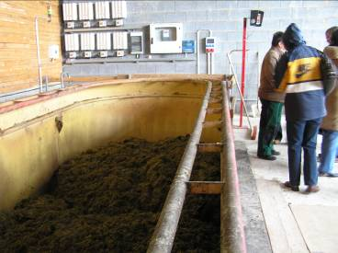
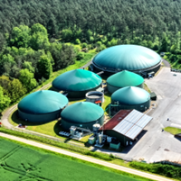
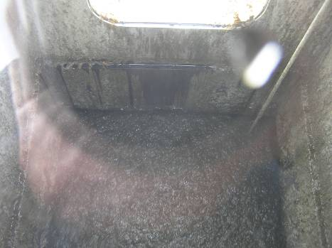
Biogas Plant
Plants or animal waste is ‘fermented’ to produce Methane. Methane can be burned – to turn water to steam……
Animal Slurry from the Dairy farm and nearby pig farms is ‘mashed up’, water is added and it ‘ferments’.
© Adobe images 2022 437044973 stock.adobe.com
The methane is collected and piped off to power plant. The remains of the slurry are sprayed onto fields as a fertiliser.

Slide 17
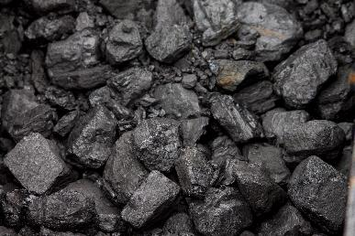
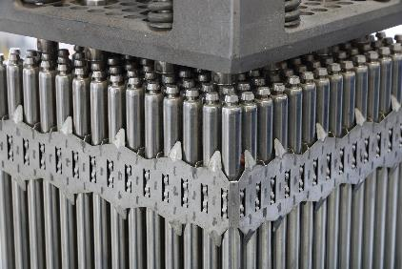
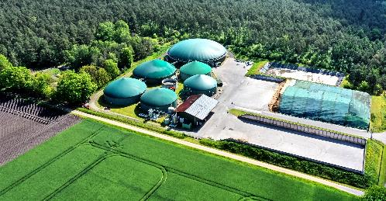
Which energy sources are RENEWABLE and which are NON-RENEWABLE ?
Which do you think Britain uses most at present?
© Adobe images 2022 437044973 stock.adobe.com
Images © Pixabay 2022 unless otherwise stated

Slide 18
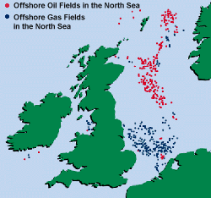
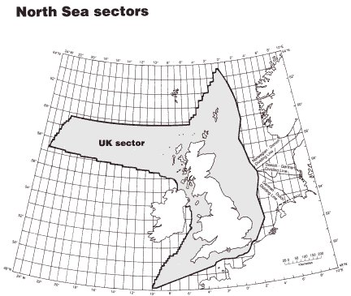
The Energy Problem
Oil and Gas
Since the 1970s Britain has supplied itself with Oil and Gas from the North Sea. But these reserves are now running out and will probably be used up in the next 15 years

Slide 19
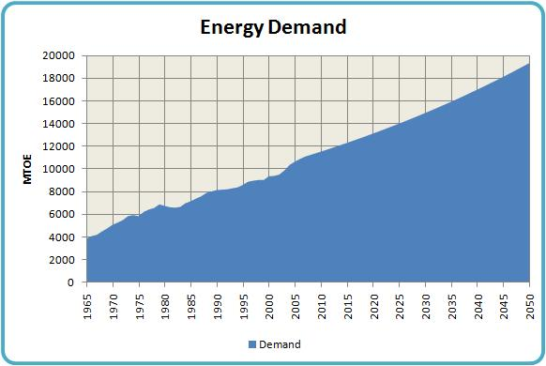
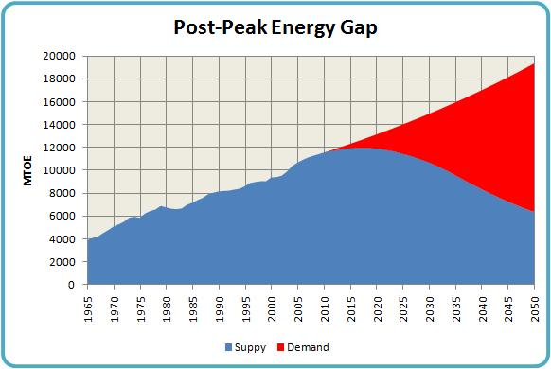
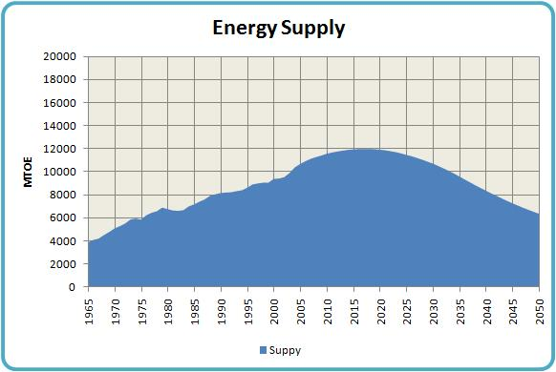

Slide 20
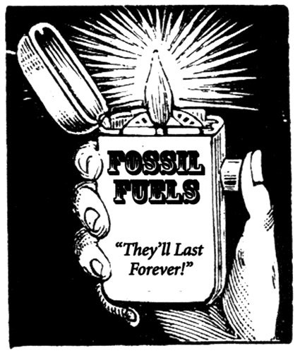
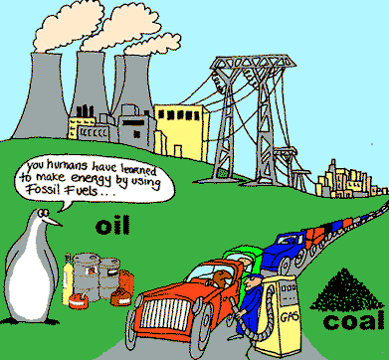
The Main Energy Producers in Britain are facing a problem

Slide 21
Life without Electricity : Power Cut !!
© Adobe images 2022 346422916 stock.adobe.com

Slide 22
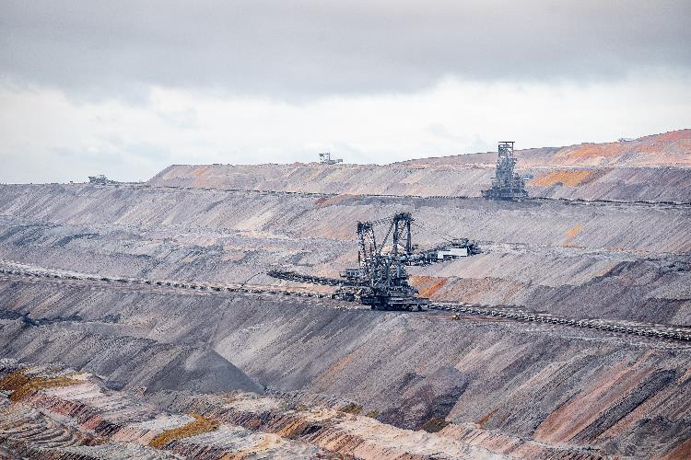
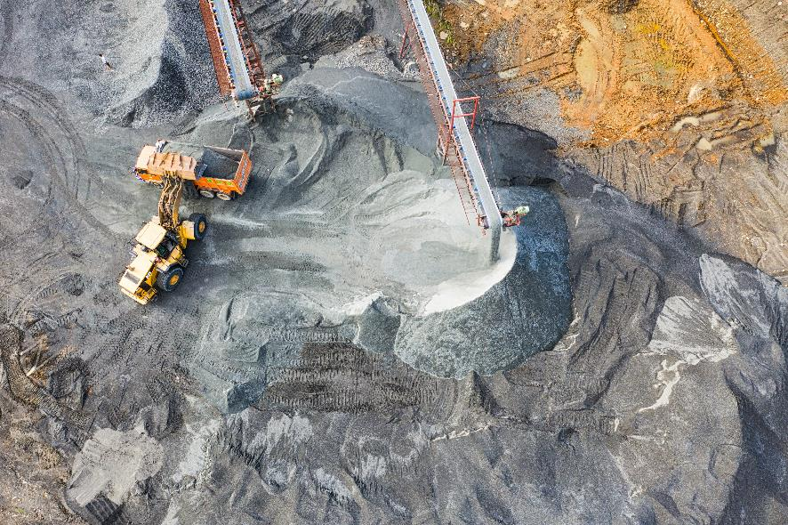
Britain has huge amounts of coal – enough for 300 years. So should we use this for our energy supplies in the future?
© Pexels.com Mike van Schoonderwalt 2022
© Pexels.com Tom Fisk 2022

Slide 23
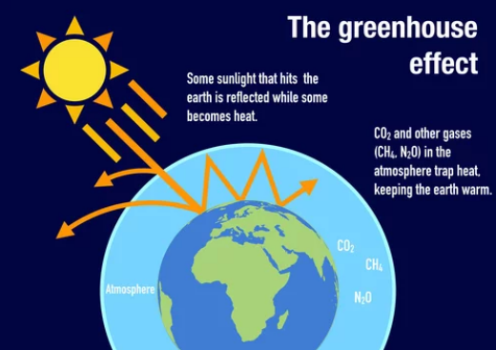
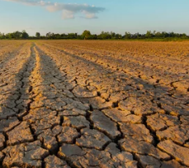
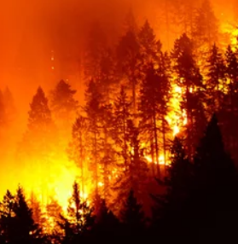
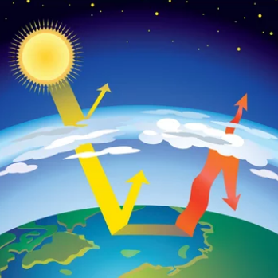
Images © Adobe Stock Images

Slide 24
© Pixabay 2022
Is there another solution to Britain’s energy problem?
Britain is one of the windiest places in Europe

Slide 25
© Adobe Stock Images
More reliable wind than on-shore wind farms, far more turbines, with far less public outcry
© Adobe Stock Images
The current UK government plan is to have 20% of Britain’s electricity generated by renewable energy by 2020. Most of this will come from 9 huge offshore wind farms that are being developed around Britain’s coast. The 3 most massive off the east coast of England.

Slide 29
What’s the big energy problem facing Britain?
Why don’t we use our coal supplies to fix the problem?
What’s the energy solution the government is going for – and why this one?
Why will this be so important for people living in North East England?

Slide 31
What will be the effects of Global Warming if we carry on using fossil fuels?
Effect | Reason | This could lead to…. | Country | Seriousness

