Slide 1
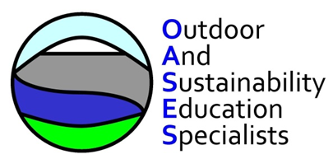
Champions for Wind Project
Yr 5/ 6 Activities
Rich Hurst and Emma Hawthorne
OASES

Slide 2
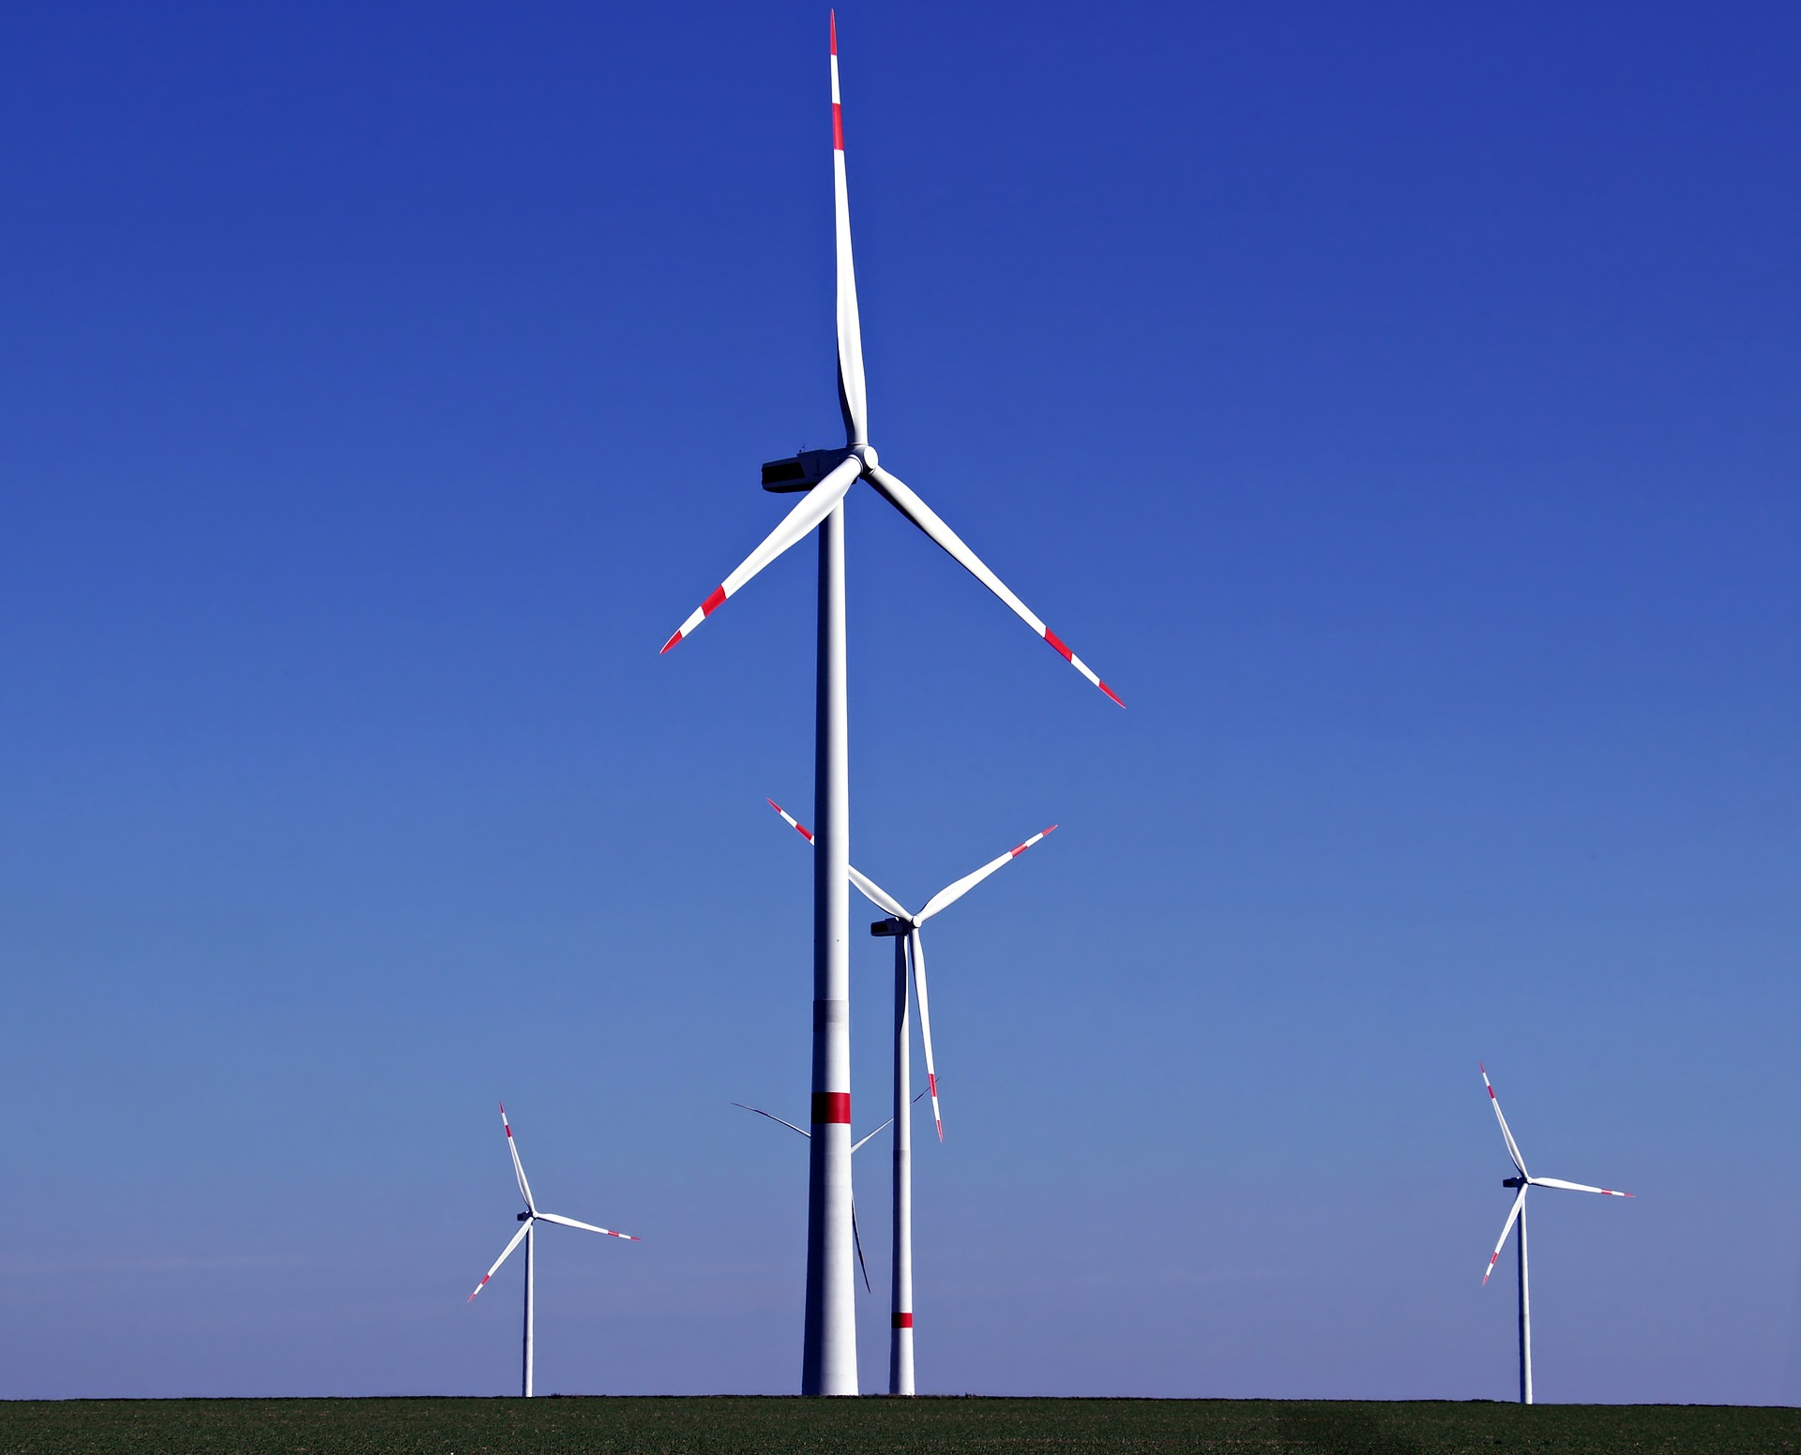
© Adobe Stock Images

Slide 3
Forewind Promotional Film
Play: https://www.youtube.com/watch?v=FLD2wf43fnA

Slide 4
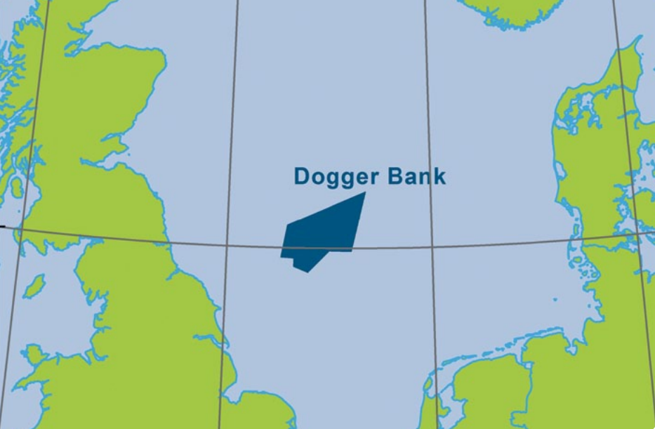
Forewind
Forewind is committed to securing all necessary consents required for the construction and development of safe, economically viable offshore wind capacity on Dogger Bank.
Dogger Bank key facts:
Capacity: 7.2GW (first six projects)
Area: 8660km², largest zone, equivalent size to North Yorkshire.
Distance: 125-290 km from shore.
Depth: 18-63 m; c.4 GW in <30m water depth, c.8 GW in <35m water depth; shallow compared with other zones.
Wind: High wind speeds of >10 m/s average wind speed across the zone.
History: A "dogger“ was a type of Dutch fishing boat that commonly worked in the North Sea in the seventeenth century.
Middlesbrough
Hull
Notes:
Forewind - a consortium of leading energy companies:
Joined forces to bid for the Dogger Bank Zone - part of The Crown Estate’s third licence round for UK offshore wind farms (Round 3) in 2010.
Forewind combines extensive experience of international offshore project delivery and renewables development, construction, asset management and operations, with UK utility expertise spanning the complete electricity value chain.
Together as Forewind we have the experience and expertise to deliver the extraordinary challenges facing all Round 3 developers.
Forewind is committed to securing all necessary consents required for the construction and development of Dogger Bank.

Slide 5
Dogger Bank Zone – size comparison

Slide 6
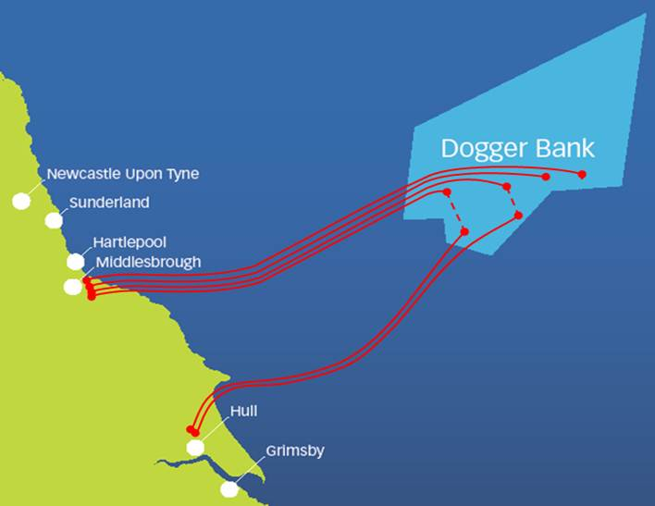
Grid Connections
Each Dogger Bank project up to 1.2 GW offshore, linked to National Grid via 1GW connections.
Dogger Bank Creyke Beck A&B
Forewind’s first two projects, connection near Cottingham, East Yorkshire – planning application submitted August 2013.
Dogger Bank Teesside A&B
Connecting at Lackenby on Teesside – planning application expected spring 2014.
Dogger Bank Teesside C&D
Two further projects also connecting on Teesside – planned for submission one year after Teesside A&B.
Zone appraisal work has identified the possibility for up to eight projects, with a total capacity over 9 GW.
Project | Connection point | Earliest Connection date
Creyke Beck A | Creyke Beck, Yorkshire | Apr 2019
Teesside A | Lackenby, Teesside | Apr 2018
Teesside B | Lackenby, Teesside | Apr 2018
Creyke Beck B | Creyke Beck, Yorkshire | Apr 2019
Teesside C | Tod Point, Teesside | Apr 2019
Teesside D | Tod Point, Teesside | Apr 2020
Forewind has secured the best available grid connection points for 6 GW of capacity.

Slide 7
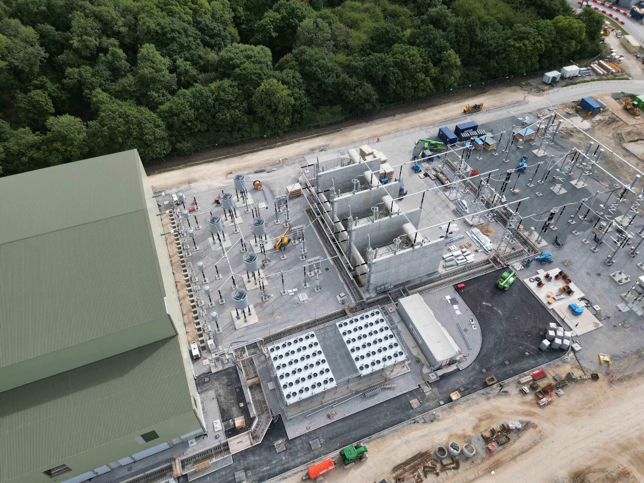
On Shore Grid Connections
The electricity cables will meet the land (underground) south of Redcar and north of Hull.
Example of a Convertor Sub Station building. © Adobe Stock Images.

Slide 8
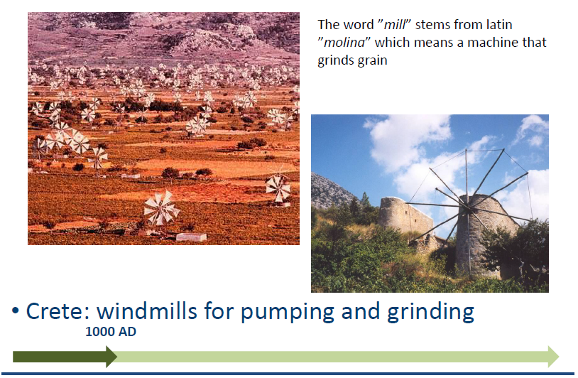

A Brief History of Wind Energy
© Adobe Stock Images

Slide 9
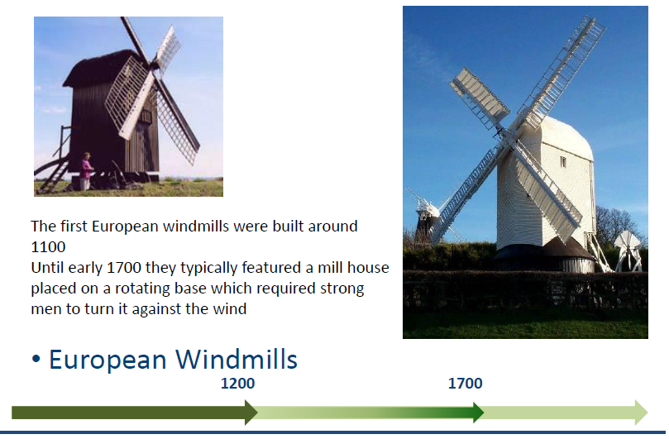
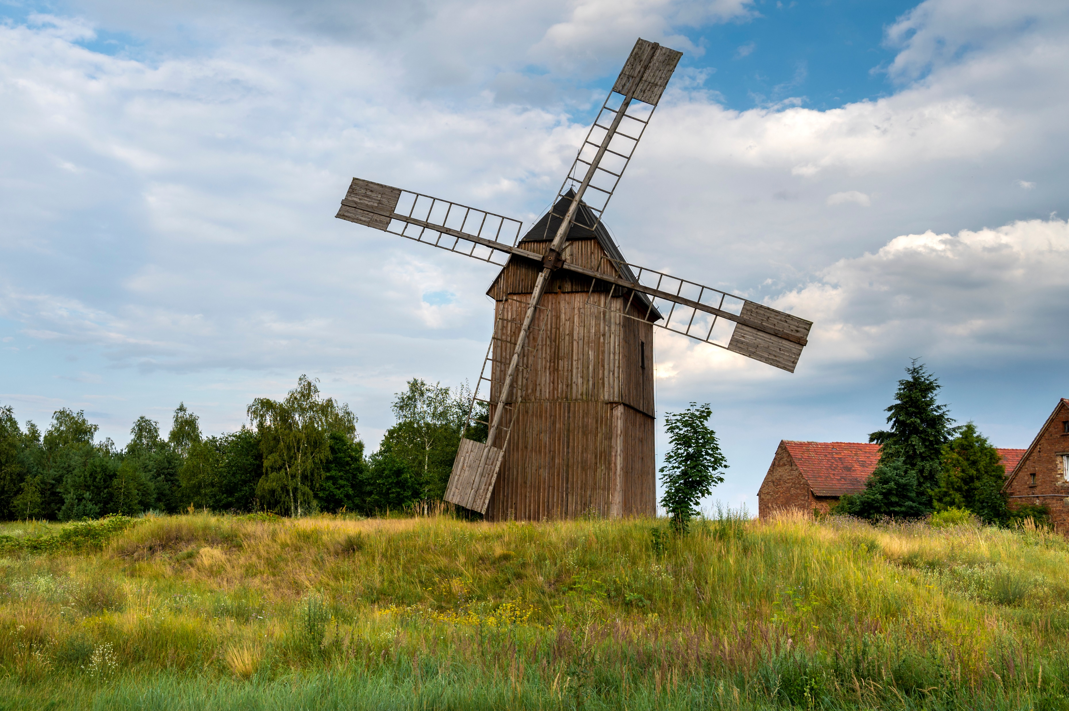
© Adobe Stock Images

Slide 10
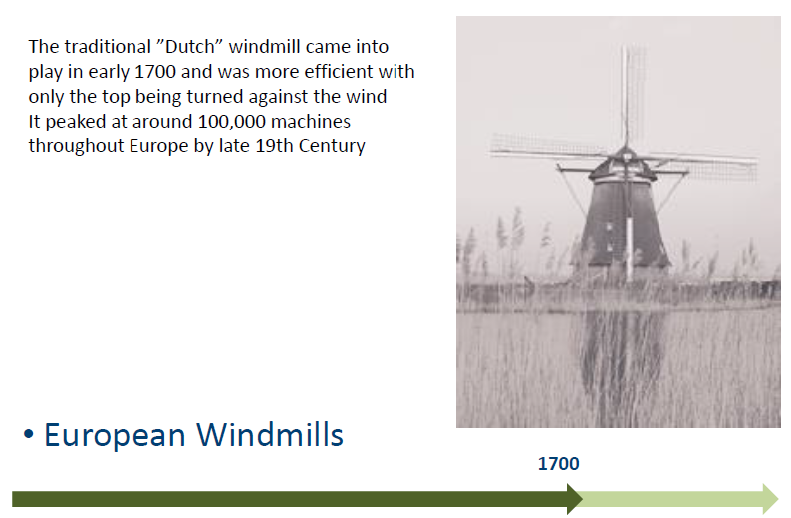
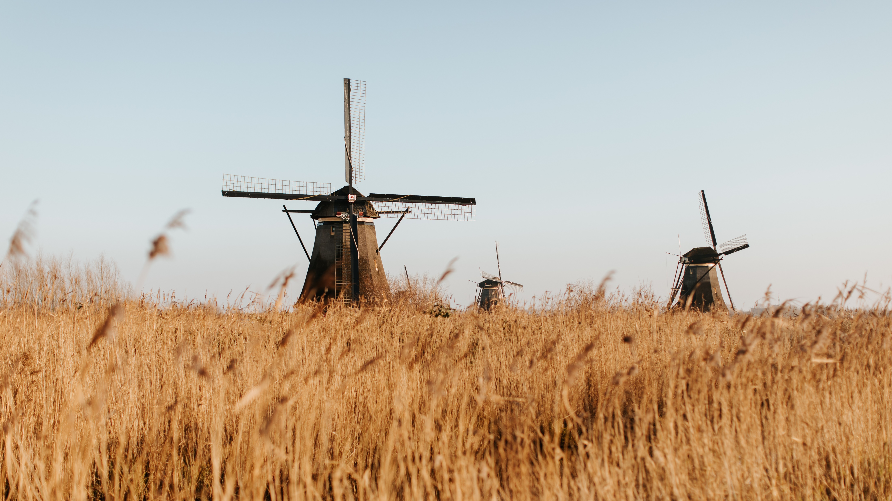
© Adobe Stock Images

Slide 11
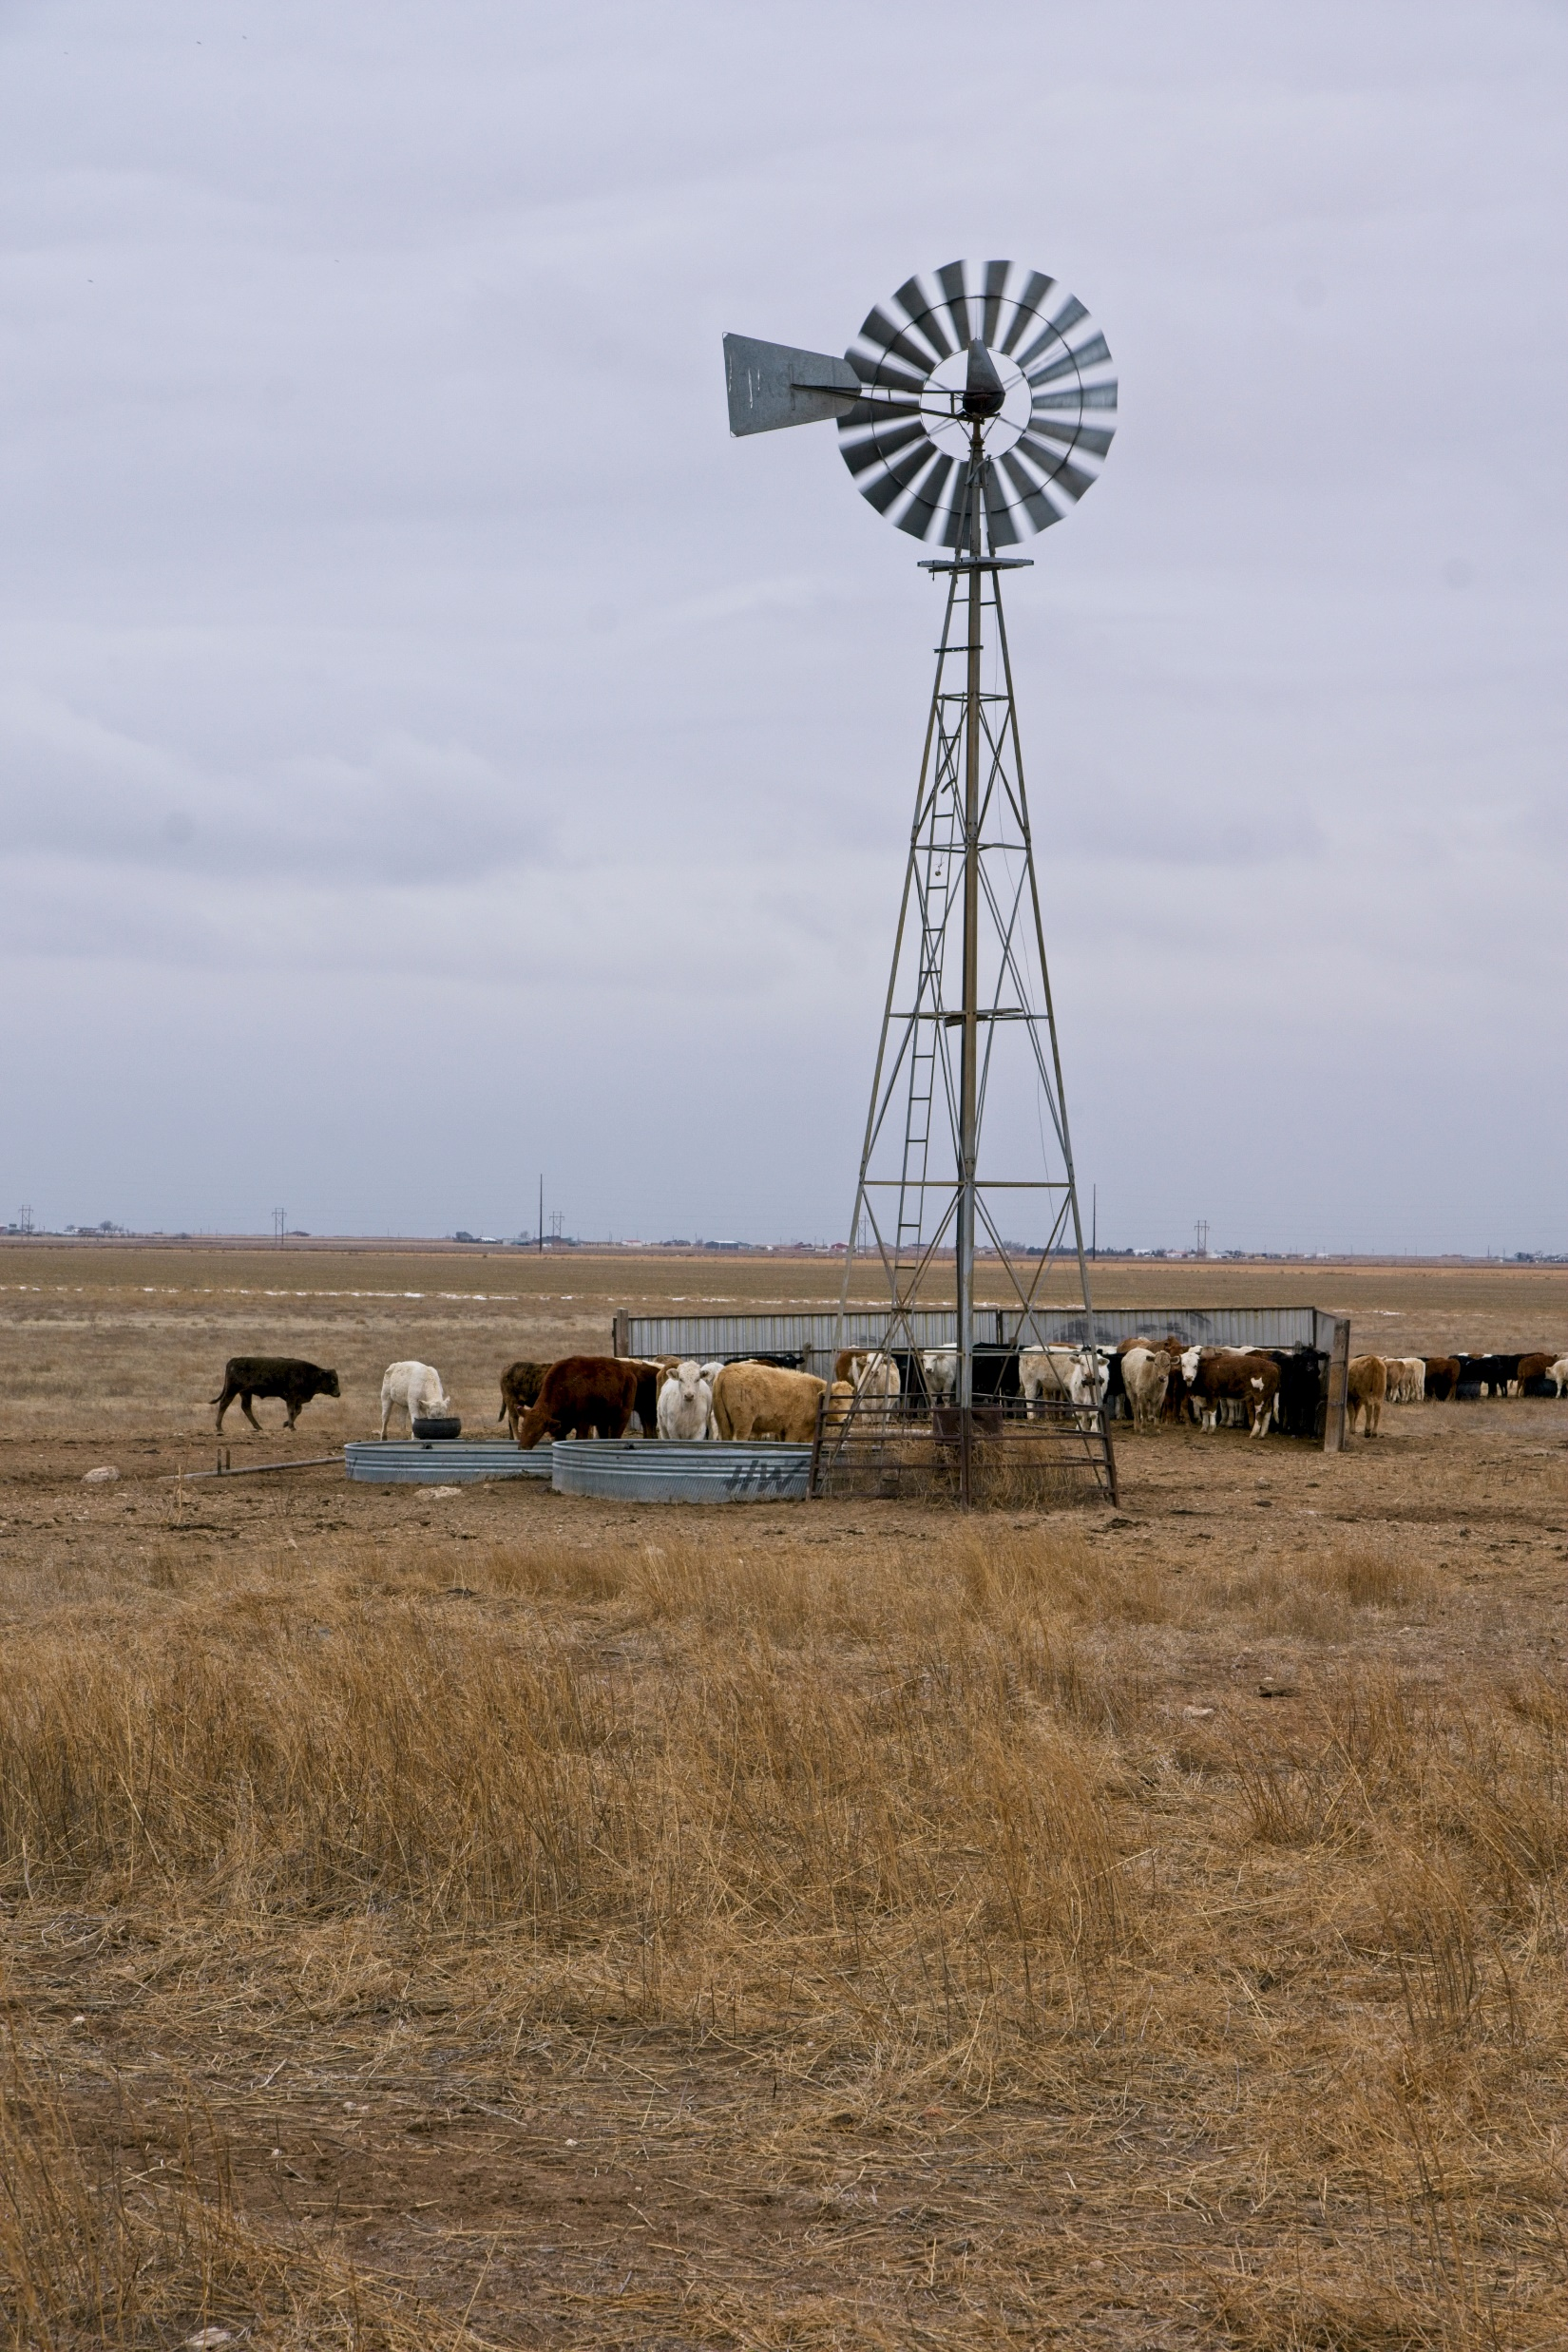
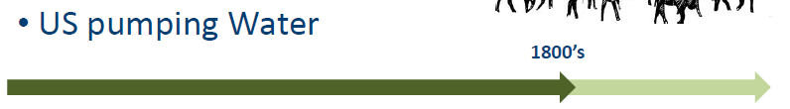
© Adobe Stock Images

Slide 12

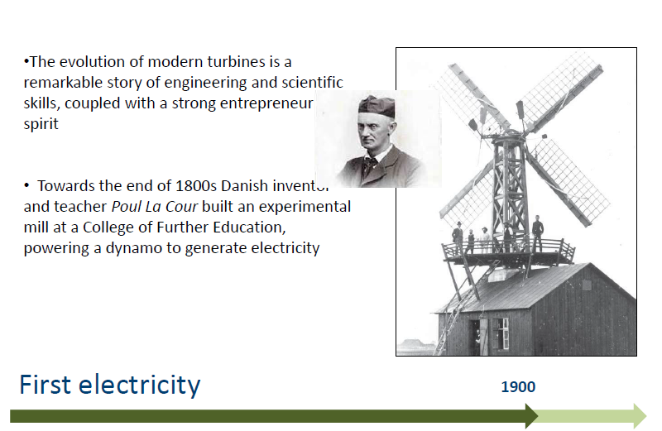
© Pixabay

Slide 13
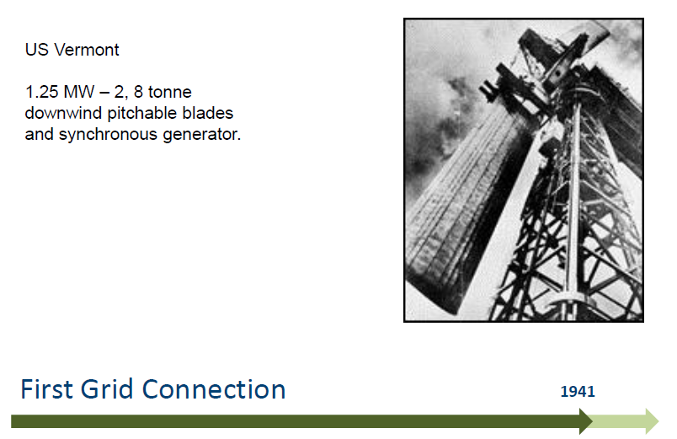

© Pixabay

Slide 14
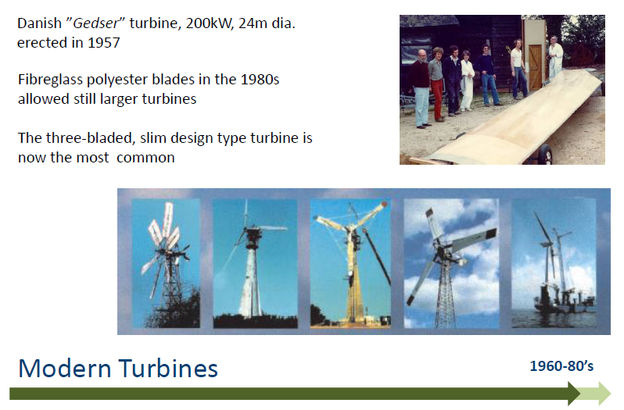
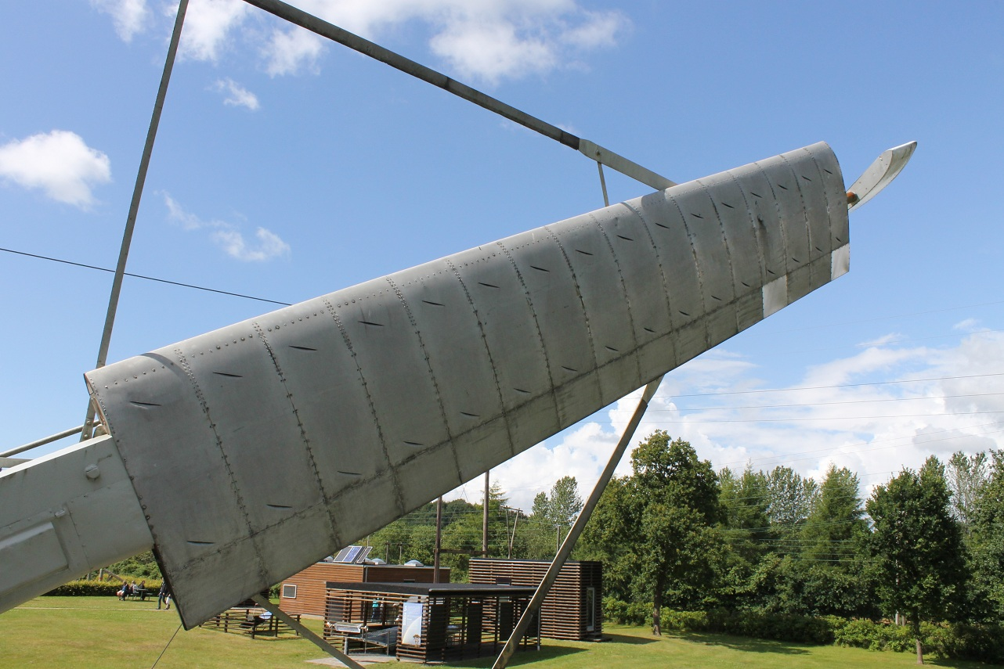
© Adobe Stock Images
© en.wind-turbine-models.com

Slide 15
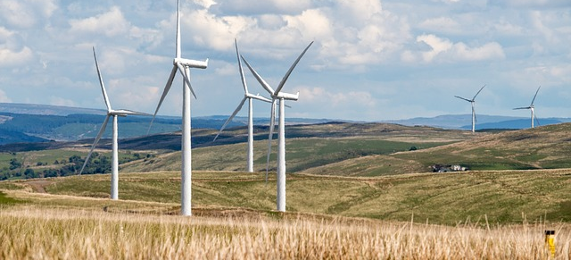
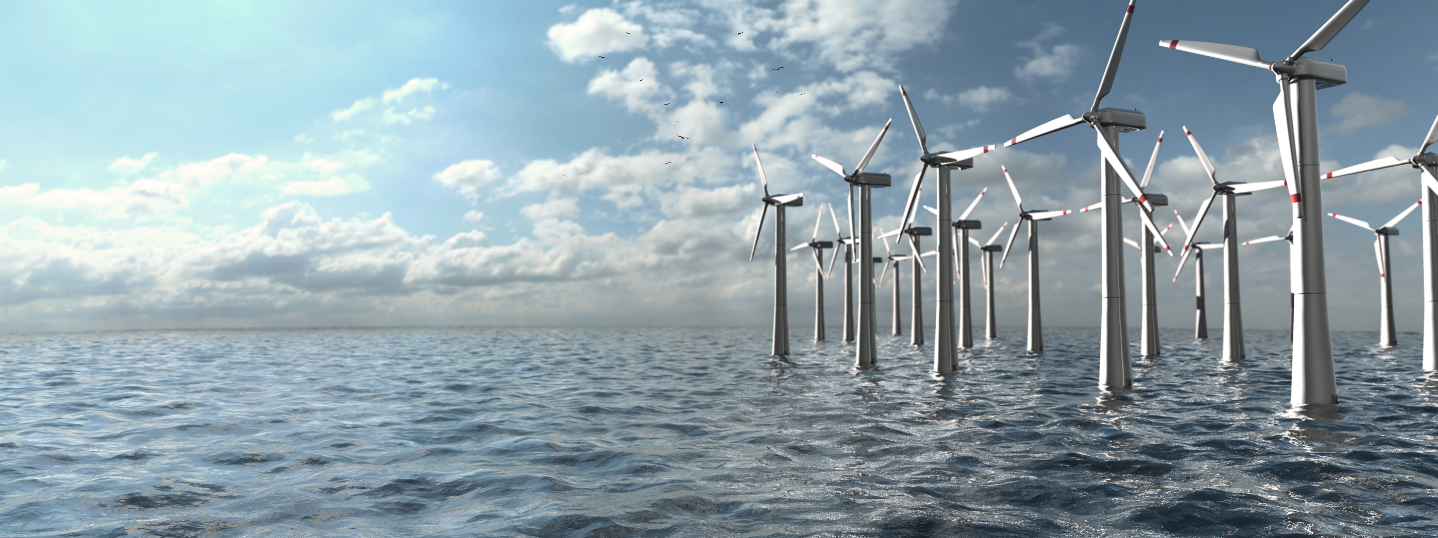
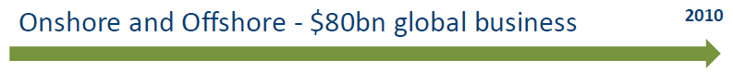
© Pixabay
© Adobe Stock Images

Slide 16
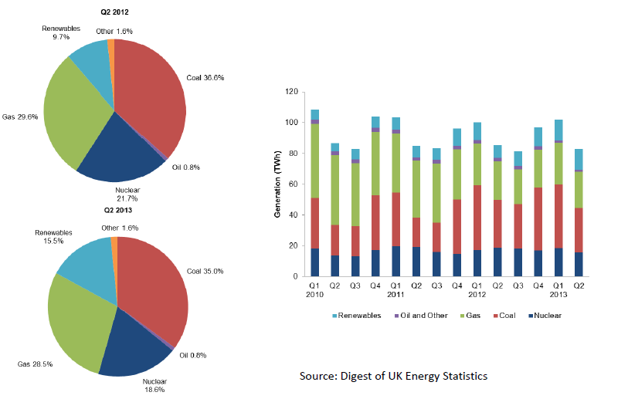
UK Energy Supply

Slide 17
Offshore Wind Turbine Film
Play offshore turbine industry film:
https://www.youtube.com/watch?v=CLFX0n7WRA4

Slide 18
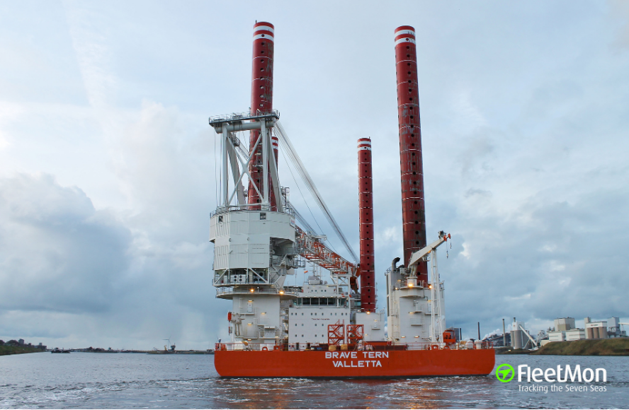
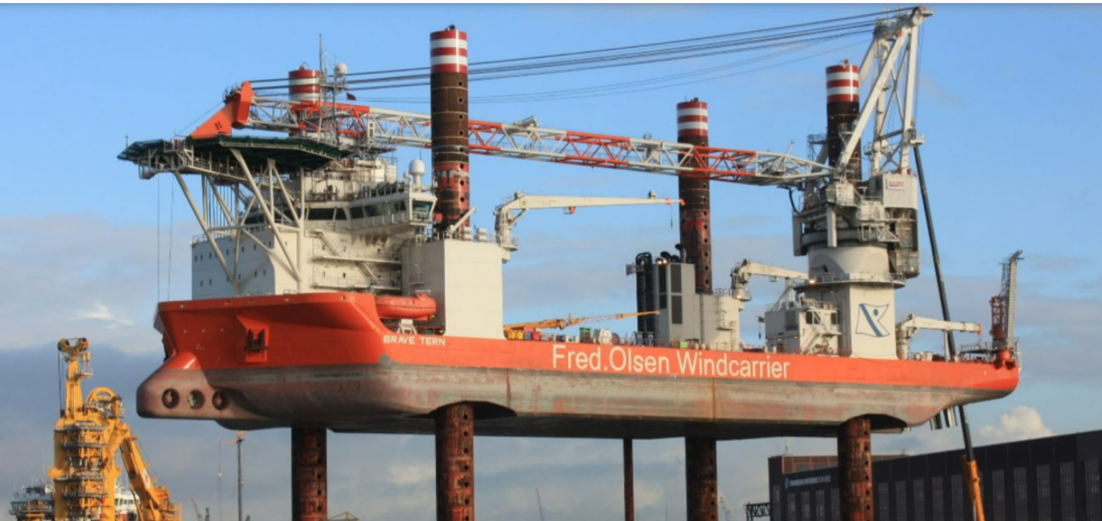
New build vessel – “Brave Tern”
© Peter Beentjes
© Franklin Offshore Europe

Slide 19
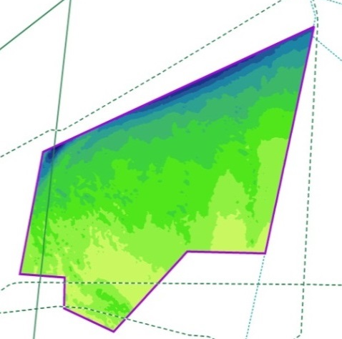

Zone development approach
Creyke Beck B
Teesside A
B
A
Teesside B
Creyke Beck A
Survey tranches
  Most promising areas prioritised for detailed surveying; first area “A” then “B”.
  Onshore grid connections agreed.
  Cable routes to shore identified, starting with reconnaissance survey grids.
.
Zone
  Coarse zone-wide surveys.
  Zone appraisal work-shops with stakeholders at start of programme.
  Consent “heat map” and hard constraints identified.
  Relative cost of energy crudely modelled.
Developable area
  Area of high fishing intensity, bird density, and more complicated geology to west of Zone excluded.
  Deeper water, with slope habitat to north of Zone excluded.
Project areas
  Narrowing down from zone to tranche to specific project areas.
  Based on detailed environmental assessment and detailed wind resource modelling.
  Stakeholder engagement and consultation throughout.

Slide 20
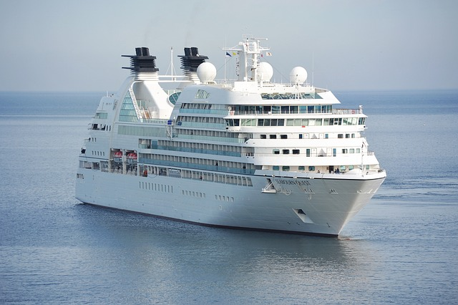
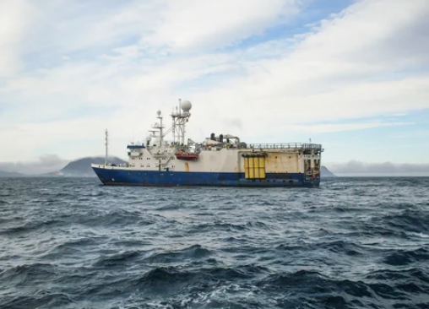
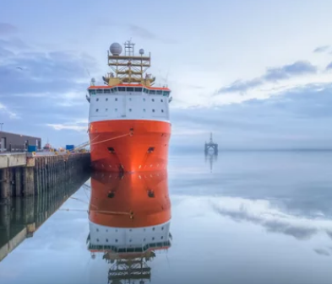
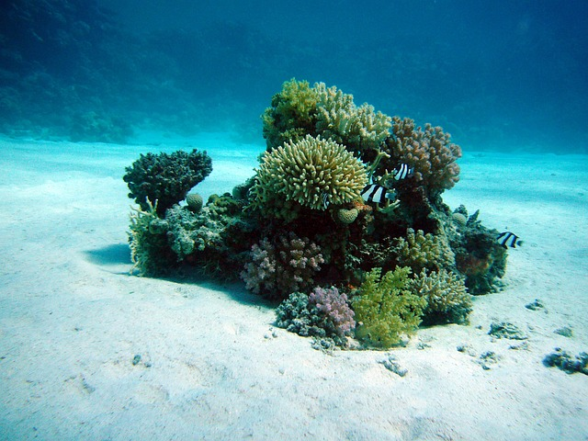
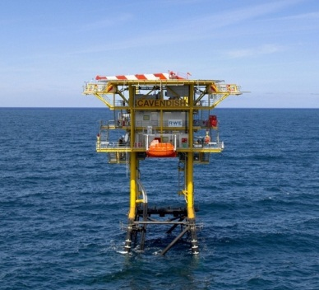
Marine operations
Ornithology and Marine Mammals
  Boat-based and aerial surveys since 2010 - more than two years of survey data will have been acquired.
  Boat: 2400 line km per month
  Aerial: several days per month, two aircraft (on-going)
Geophysics
  Coarse zone wide survey – 7,000 line km covering 8,660 km².
  Detailed survey, two campaigns – 40,000 line km (covering 3,500 km²).
  Cable corridor surveys to Yorkshire and Teesside.
  Next tranche of surveying (for Projects 5 & 6) commenced in 2013.
Geotechnical
  84 boreholes and 174 cone penetration tests over three separate campaigns.
  Dedicated investigation of seismic anomalies.
  Sophisticated geological modelling (with British Geological Survey and Norwegian Geotechnical Institute).
Benthic
  106 camera sites, 103 macrofaunal sampling sites, 15 chemical sampling sites in first season.
  82 camera sites, 44 macrofaunal sampling sites, 6 chemical sampling sites on Yorkshire cable route.
  Similar campaign season for Teesside 2012.
  Multiple fish surveys, both zone and cable routes.
Met ocean
  Two buoys to acquire oceanographic and meteorological data installed Autumn 2010.
  LIDAR installed on RWE Cavendish platform, Summer 2011.
  Acoustic doppler current profiler (ADCP) installed.
  Two innovative met masts installed.
Images © Adobe Stock, Pixabay, RWE DEA
Notes:
Surveys form an integral aspect of the development process and the resulting information will be used to assist with tranche and/or project selection as well as informing the Environmental Impact Assessment. The following surveys are underway or have been completed.
A big part of our activity remains operational data collection – particularly in the difficult marine environment.
We’ve continued with our hands on approach to managing offshore contracts, with a strong Forewind presence, typically with our own reps.
Regrettably we’ve had some incidents, including some serious near misses – but we’ve followed these up well and shared findings with the rest of the industry.
We’ve delivered. An enormous amount of survey work; despite some tough weather conditions:
Bird surveys - 2½ years of almost continuous boat-based survey completed with Gardline.
Metocean – despite the mysterious incident of the disappearing buoys.
Geophysics
Benthic
Fish ecology
Geotech
And site surveys for the met masts.

Slide 21
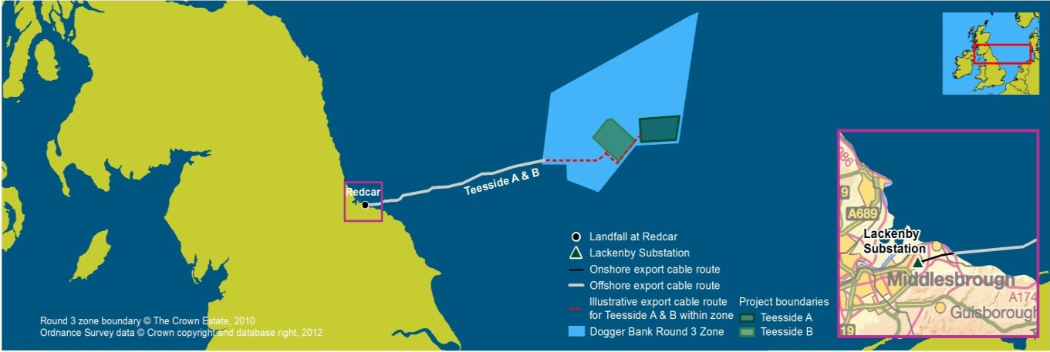
Summary of progress:
Dogger Bank Teesside A&B
Lessons from Creyke Beck project incorporated.
Scoping consultation completed.
Environmental surveys: onshore and offshore completed.
Consultation with statutory bodies on-going. Community stakeholder discussions on-going.
Final consultation phase in Q3 2013.
Submission of planning application and development consent order scheduled for end-March 2014.
Date | Activity
Q2 2012 | First stage of statutory consultation
2012 - 2013 | Environmental surveys and reporting
Q3 2013 22-23 & 25 Nov | Second stage of statutory consultation Public exhibitions @ Teesside
Q1 2014 | Submit applications for development consent order(s)
April/May 2014 | Application acceptance
2014 – Q2 2015 | Examination and decision on DCO award
2015 - 2017 | Pre-construction phase – Design & Tender
2016 - 2021 | Manufacture & Construction
2017 onwards | (Earliest) Operation 50 years ! (25 x 2)

Slide 22
Process and Costs
Concept
and bidding
Consenting
Front end engineering and design (FEED)
Financial investment decision (FID)
Construction
Operation and maintenance
Decommission
or repower
Forewind exists to achieve development consent for Dogger Bank projects.
Despite the tough economic climate, in partnership with the Crown Estate, shareholders have to date already invested over £78m developing the Zone.
Each Dogger Bank project will require a massive investment, in the order of £3bn – £4bn.
Forewind’s shareholder companies will each take the role of lead operator, guiding individual projects once consent is received, to financial close and then into construction and operation.

Slide 23
Discussion and Questions

Slide 24
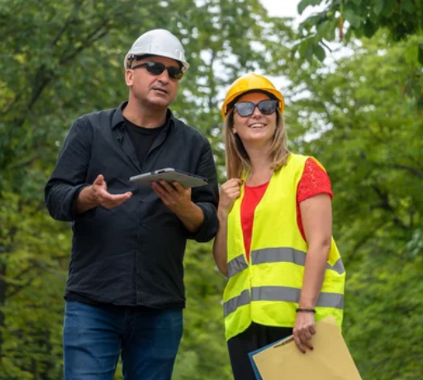
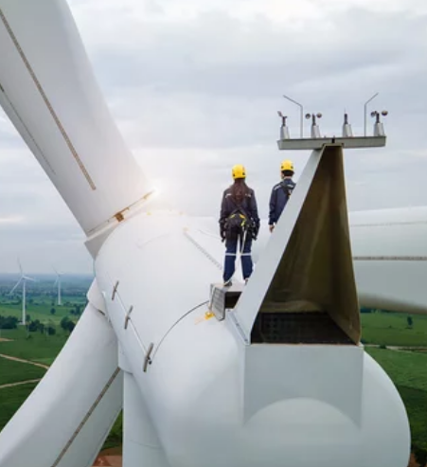
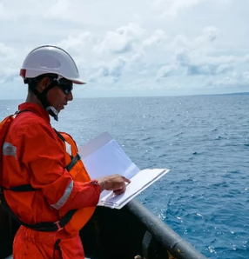
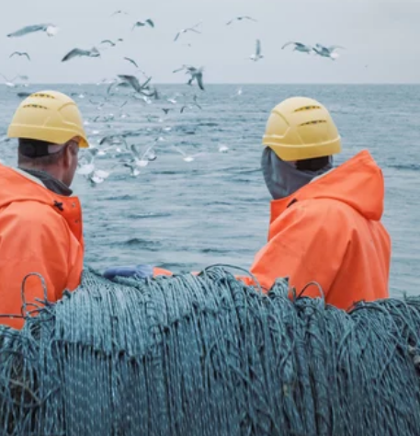
Session 2
  Split into 3 groups to do research
    Biodiversity
    Energy
    Skills and Careers
Images © Adobe Stock

Slide 25
Biodiversity Group
  Biodiversity Group; Research and present findings relating to the following 5 surveys undertaken by Forewind:
    Fish
    Birds
    Archaeology
    Mammals
    Aviation/ military aircraft

Slide 26
Energy Group
  Research and present findings relating to the enquiry question:
  ‘Do we need Offshore Wind Energy?’
    5 learners ‘for’ Offshore Wind
    5 learners ‘against’ Offshore Wind
    Then debate your position for 10 minutes (5 mins approx each team)

Slide 27
Skills and Careers Group
  Skills and Careers Group;
  Research and present findings relating to 5 jobs associated with Offshore Wind from the Crown Estate Careers Brochure.
  Assess:
    Qualifications needed
    Experience
    Salary Range
    Responsibilities
    Best aspects of the jobs
Careers to Research:
Hydrographic Surveyor
Offshore Renewables Developer
Welding Engineer
Control Systems Specialist
Skipper Wind Farm Service Vessel

Slide 28
Biodiversity Group
  Research and present findings relating to the following surveys undertaken by Forewind:
  Individual Chapters can be downloaded from: ??
    Fish (Chapter 6.15. Pages 340-347)
    Birds (Chapter 6.11. Pages 342 – 363)
    Archaeology (Chapter 6.18. Pages 166 – 172)
    Mammals (Chapter 6.14. Pages 266 – 272)
    Aviation/ military aircraft (Chapter 6.19 pages 57-61)

Slide 29
Next Session
  Continue with your research and develop your class presentations to be shared at the next lesson.
    Biodiversity
    Energy
    Skills and Careers
Images © Adobe Stock

Slide 30

Whole School or Year Group Activity
Watch the video from St Anne’s CE Primary School in County Durham:
https://www.youtube.com/watch?v=yiAWEihSmZo
This was developed and filmed by drone company isky to show the scale of the offshore turbines in 2014. Since then the newer offshore turbines are even bigger
How else could you display the scale?
  Stop motion animation/ computer generated/ VR?

Slide 31
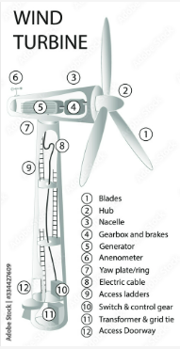
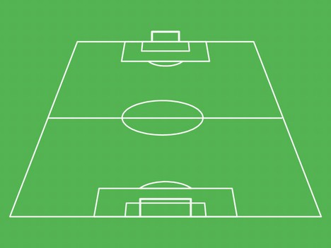
Mapping an Offshore Wind Turbine on School Field
Notes:
The 35km² East Lincs wind farm will consist of 75 turbines in a depth of between 10-15m water in the North Sea. The project, costing £725m, will generate 250MW of electricity annually. The rotor blades will be 58.5m long and the rotor will be 120m diameter. The maximum height to the tip of the blade will be 170m. In layman’s terms this is about the height of 23 double-decker buses.
The turbines will be spaced at a distance of 500m. The hub height will be 100m. The narcelle and the hub of the turbines will be installed on top of the turbine tower. This will be supported by a foundation attached to the seabed.

Slide 32
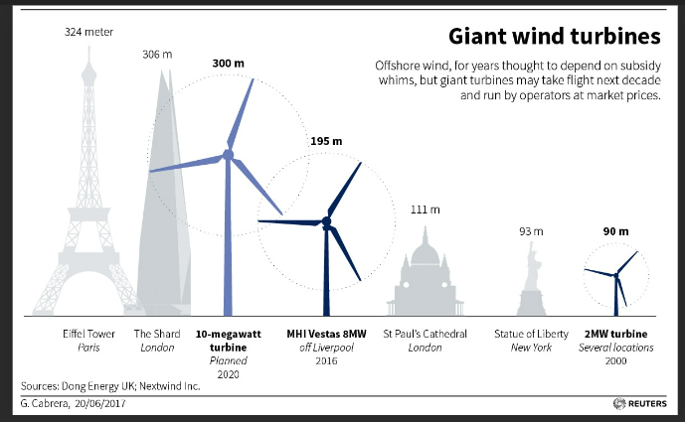
Mapping an Offshore Wind Turbine on School Field
Notes:
The turbine dimensions depend on the size (MW) of the turbines.

