Slide 1
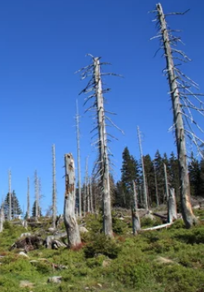
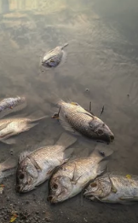
Acid Rain Victim - For
Image © Adobe Stock
Acid rain is rain that contains nitric and Sulphuric acid. Aluminium created by acid rain makes the sea, lakes, and streams, toxic. The animals that can survive the changes in the water's natural minerals might survive, but quickly lose their food source as the weaker creatures die off. Animals that cannot withstand it die, fail to reproduce, become deformed, or fail to grow normally.
Acid rain directly impacts forest and the damage to the forest trees and plants is widespread. Acid rain damages leaves as it falls then Acid rain runoff from the trees and forest floors gets in to the forest's water supplies. The consequence of this is the plants and creatures die off, and the creatures that rely on those plants and smaller creatures lose their food source and die, as well.
Plants and animals aren't the only victims of acid rain. Acid rain is dangerous to people. Studies show an increase of conditions, such as asthma and bronchitis, in people who are regularly exposed to acid rain
Image © Adobe Stock

Slide 2
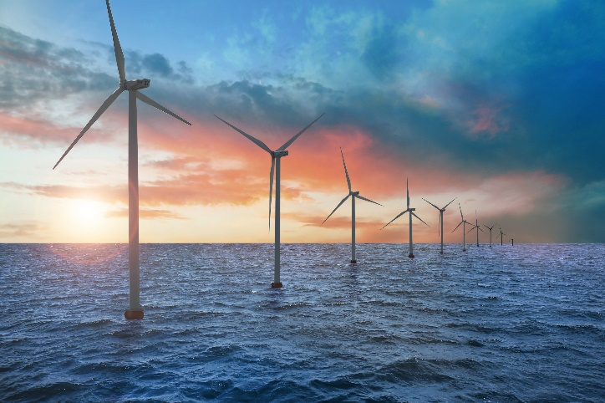
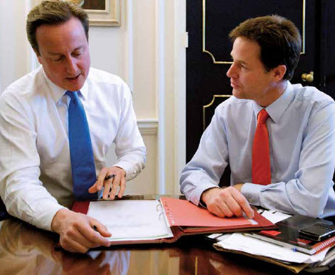
The Government - For
Our attempts to increase the amount of energy we get from renewable sources will not only increase the security of energy supplies in the UK; it will also provide opportunities for investment in new industries and new technologies.
The Government will help business develop in this area to put the UK at the forefront of new renewable technologies and skills. We will need to train a new work force to deal with our up coming energy demands in the future and renewable is going to be a big part of that.
In 2008 the total energy consumed by the UK was around 2% of the worldwide total however the UK has under 1% of the global population. This will start to become a problem in the future unless we start to produce our own power.
http://www.guardian.co.uk/environment/2012/jun/13/offshore-wind-power-cost?newsfeed=true
Image © Adobe Stock

Slide 3
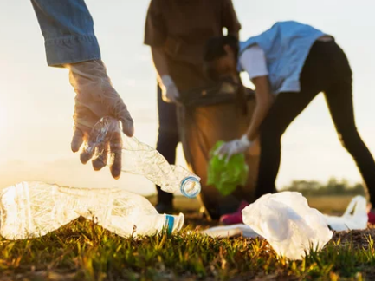
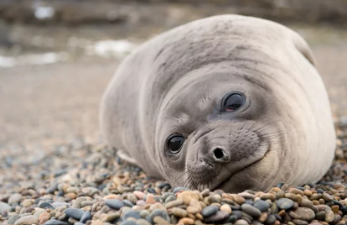
Marine Preservation Group - For
The Marine Preservation Group is the voice for everyone who loves the sea. We work to secure a future for our living seas, and to save our threatened sea life before it is lost forever. Our wonderful seas, shores and wildlife are under threat in lots of places around the UK. Almost nowhere in UK seas is marine wildlife safe from harm. We need to establish vital marine protected areas where wildlife can recover and flourish. Our work ensures that the sea’s rich wildlife can be restored, fish stocks grow more plentiful, and our beaches and seawater become cleaner. Current research shows that the offshore wind turbine development may actually be beneficial for lots of species of fish once the turbines have been built and become established.
(Similar group to research)
Image © Adobe Stock
Image © Adobe Stock
http://www.kentnews.co.uk/news/wind_farms_could_create_new_habitats_for_marine_life_1_1074889

Slide 4
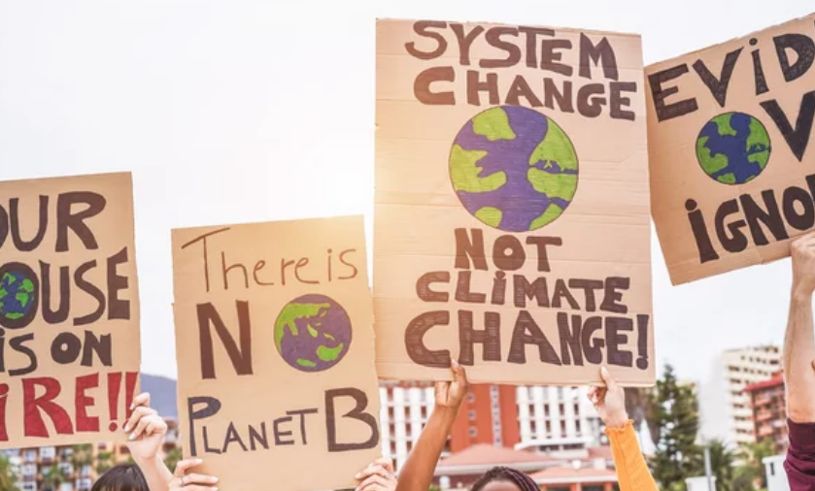
Greenspace - For
Image © Adobe Stock
We are passionate about protecting the Earth – the only life support system we have. We are investigating, documenting and exposing the causes of environmental destruction. We work to bring about change through political lobbying, citizen action and consumer pressure. And we will take peaceful direct action to protect this fragile planet and promote the solutions for a green and peaceful future. Climate change isn't inevitable. We have the knowledge, skills and technologies to get ourselves out of this difficult situation. All over the world people have woken up to the threat, and are working to reduce the use of fossil fuels and get power from clean energy. Still much more needs to be done (Similar group to research)
http://www.greenpeace.org/international/en/publications/reports/offshore-wind-implementing-a/

Slide 5
Local Unemployed People - For
Image © Adobe Stock
The North-East and Yorkshire is an excellent place to support the new growth in the offshore wind power industry:
The region’s ports enjoy easy access to the large proposed wind development areas on the east coast, and to other European sites. The long industrial history and established manufacturing capacity of the region, makes the North-East a natural target for wind turbine investment.
Underlying unemployment rates mean that the North-East’s workforce could support the rapid growth of wind turbine manufacturing, and benefit greatly from the economic activity so created. By 2020, 17,000 full time jobs could be created in the Wind turbine industry if the government continue to support its growth.
There are currently about 148,000 unemployed people in the North East of the UK, many of these people could take up short term and full time employment in the design, construction and maintenance of the Dogger Bank wind farm.
http://www.greenpeace.org.uk/MultimediaFiles/Live/FullReport/6702.pdf

