Slide 1
5-MINUTE MEMORY CHALLENGE
TASK:
Geog your memory
What are the advantages and disadvantages of wind energy?
Be Safe. Be Respectful. Be Responsible

Slide 2
LEARNING INTENTIONS:
TOPIC QUESTION:
How important is renewable energy to my local area?
LESSON QUESTION:
What is Sofia Wind Farm?
Be Safe. Be Respectful. Be Responsible.

Slide 3
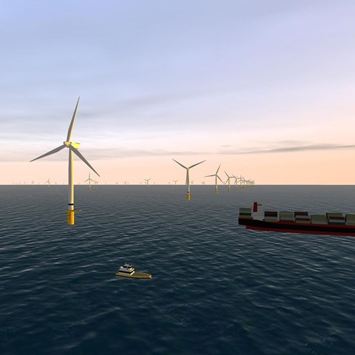
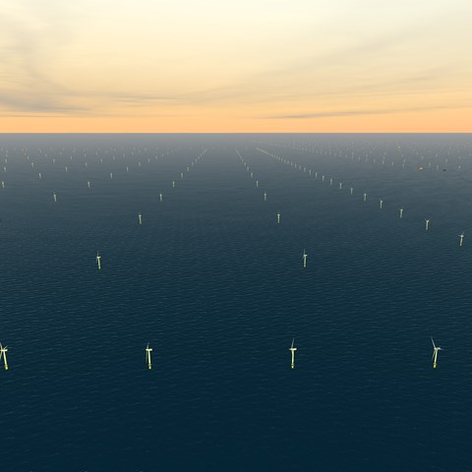
How important is renewable energy to my local area?
What is Sofia Wind Farm?
Sofia Wind Farm
Sofia will be one of the largest offshore wind farms in the world as well as one of the farthest from shore.

Slide 4
How important is renewable energy to my local area?
What is Sofia Wind Farm?
Guided Reading
Sofia Wind Farm
Where is Sofia Wind Farm located?
How does Sofia Wind Farm create
Electricity?
How tall are the wind turbines?
How does Sofia wind farm help to protect the environment?
Sofia Wind Farm is a special place in the ocean that helps create electricity using the power of the wind. It is located far away from the coast of the United Kingdom in the North Sea.
Sofia Wind Farm has really tall wind turbines that stand over 252 meters high. These turbines have big blades that spin when the wind blows. When the blades spin, they make electricity that can be used to power homes and buildings.
Sofia Wind Farm is very big, with 100 turbines in total. All of these turbines together can create a lot of electricity. In fact, they can make enough electricity to power around 1.2 million homes!
Sofia Wind Farm is important because it helps protect the environment. By using the wind's power, it doesn't create pollution like some other ways of making electricity. This helps reduce the amount of harmful gases that are released into the air, which is good for the planet.
Not only does Sofia Wind Farm help the environment, but it also helps create jobs for people. When the wind farm is built and needs to be maintained, it requires workers who can help with the construction and take care of the turbines. This creates job opportunities and helps the local economy.

Slide 5
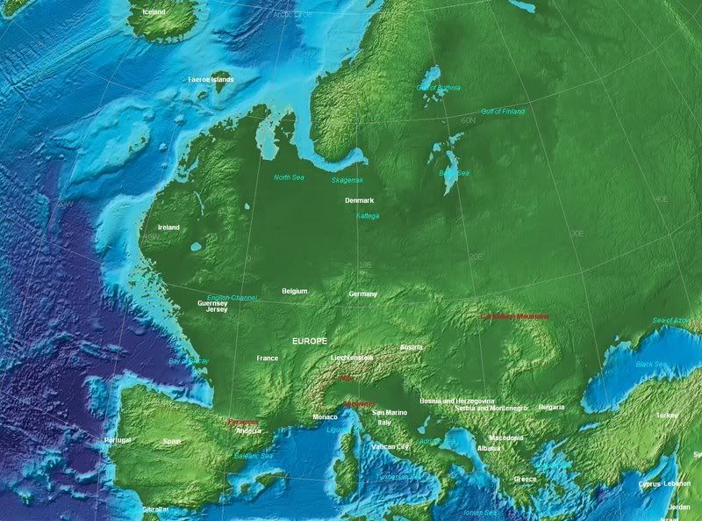
How important is renewable energy to my local area?
What is Sofia Wind Farm?
What is this map showing?
Why does it look like this?
Guidance:
Look at the map carefully, can you see anything similar or different to maps you are already aware of?

Slide 6
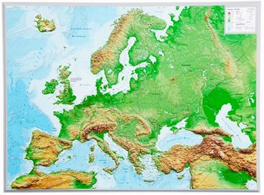
How important is renewable energy to my local area?
What is Sofia Wind Farm?
Doggerland

Slide 7
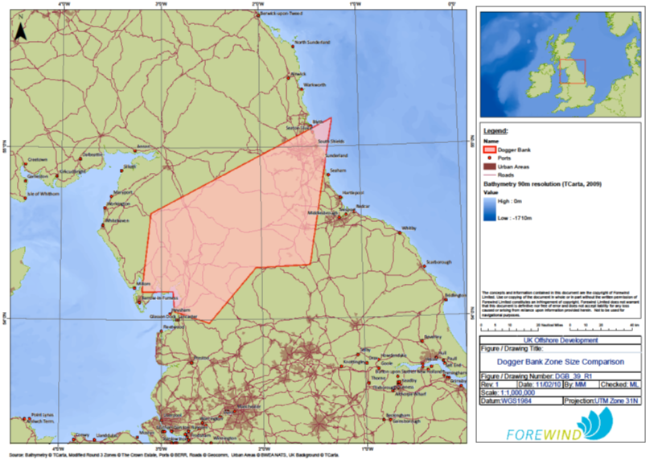
How important is renewable energy to my local area?
What is Sofia Wind Farm?

Slide 8
How important is renewable energy to my local area?
What is Sofia Wind Farm?
Discovering the Lost World: The Creation of Doggerland
Popcorn Reading
What is Doggerland?
Why did Doggerland disappear?
Would this area in the North Sea be a good location to build a wind farm? Explain why.

Slide 9
How important is renewable energy to my local area?
What is Sofia Wind Farm?
Post it… Plenary
Imagine you are a time traveller and have gone back in time.
Send a postcard to your friends and family telling them all you have found out about Doggerland.

