Slide 1
Give one reason why the evacuation of Dunkirk was a success.
Record your ideas on your mini whiteboard.
Be prepared to share with the class.

Slide 2
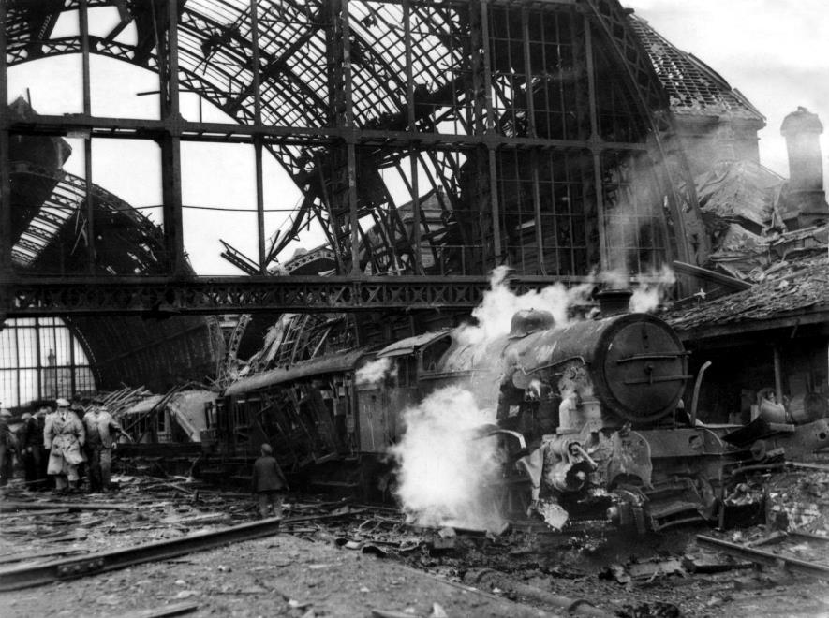
TOPIC QUESTION:
Who, When, Where, Why, How?
Stick your copy of the source and annotate in your book.
TOPIC QUESTION:

Slide 4
TOPIC QUESTION:
Who, When, Where, Why, How?
In red pen annotate what you can infer (suggest).
TOPIC QUESTION:

Slide 5
How did Britain win the war?
Where did it all go wrong for Germany?
How was Teesside affected by WW2?
Was Dunkirk a success or failure?
What was the Battle of Britain?
Economic Change
What was Blitzkrieg?
What was Britain’s relationship with Germany?
Why and how did Hitler come to power?
What was
What are the causes and significant events of WW2?

Slide 6
LEARNING INTENTIONS:
TOPIC QUESTION:
What are the causes and significant events of World War Two?
LESSON QUESTION:
How was Teesside affected by WW2?
Be Safe. Be Respectful. Be Responsible.

Slide 7
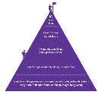
TOPIC QUESTION:
What are the causes and significant events of World War Two?
How was Teesside affected by WW2?
TOPIC QUESTION:
This photograph was taken on the 3rd August 1942, 5 minutes after Middlesbrough Railway Station was bombed by the German Luftwaffe.
Now that you know this, is there anything else you can add to your annotation?

Slide 8
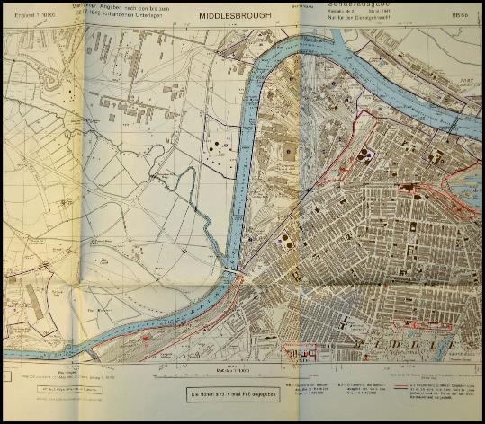
TOPIC QUESTION:
What are the causes and significant events of World War Two?
How was Teesside affected by WW2?
TOPIC QUESTION:
During World War Two, Teesside was a target for Nazi Germany.
Hitler’s forces had detailed knowledge of Teesside as part of its masterplan to invade the UK.
A collection of military maps, like this one, reveal that the Nazis had the North-East in its planned invasion - Operation Sealion.
The maps show, in red, areas of interest such as bridges, industrial depots and gas works. The Railway station was also highlighted red on one map, and we know that it was bombed in 1942.

Slide 9
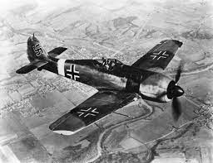
TOPIC QUESTION:
What are the causes and significant events of World War Two?
How was Teesside affected by WW2?
TOPIC QUESTION:
Why do you think Middlesbrough was the first major British town to be bombed by the German Luftwaffe?

Slide 10
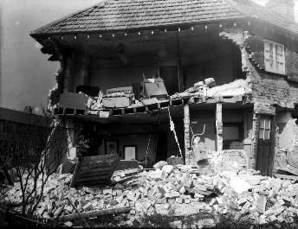
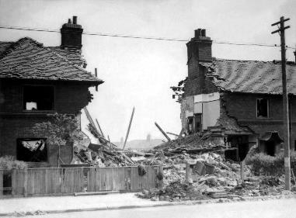
TOPIC QUESTION:
What are the causes and significant events of World War Two?
How was Teesside affected by WW2?
TOPIC QUESTION:
The importance of Middlesbrough’s iron and steel industries saw it become the first major British settlement to be bombed by the Luftwaffe.
The first attack came on the 25th May 1940 when a lone bomber dropped 13 bombs, one of which left a large crater in the pitch at South Bank football ground.
Nearly 1,000 people were killed or maimed during the Nazi bombing raids across Teesside and more than 200 buildings were destroyed.

Slide 11
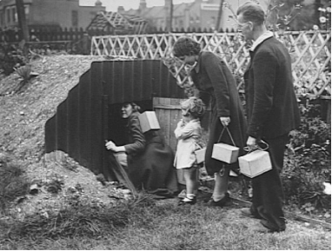
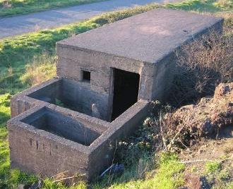
TOPIC QUESTION:
What are the causes and significant events of World War Two?
How was Teesside affected by WW2?
TOPIC QUESTION:
How did Teesside prepare for World War Two?
Gather and share
Each member of the team will receive one example of how Teesside prepared for a German attack.
1 - Pill boxes
2 - Anderson shelters
3 - Home guard
4 - Starfish decoy sites
Read the information sheet and record key points in your exercise book. Set it out in your preferred style.
Be prepared to share your information with the team.

Slide 12
TOPIC QUESTION:
What are the causes and significant events of World War Two?
How was Teesside affected by WW2?
TOPIC QUESTION:
How did Teesside prepare for World War Two?
Evaluation
Which method of preparation do you think would have been the most effective?
I believe the method of preparation that would have been the most effective was….because…

Slide 13
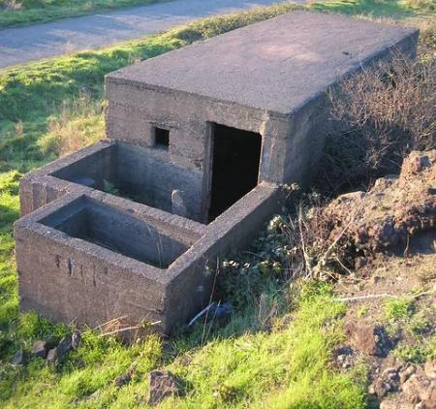
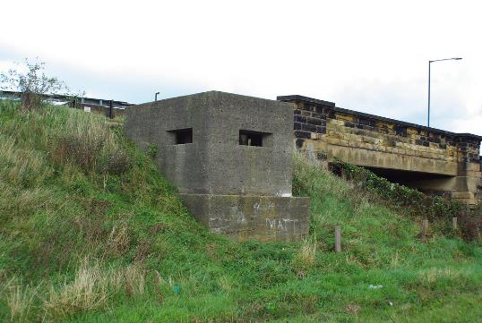
Pill boxes
Concrete ‘pill boxes’ were built for defence and were equipped with machine guns and the soldiers inside were armed with anti -tank rifles and bren guns.
They were called ‘pill boxes’ because of their shape, they looked like the boxes in which chemists supplied tablets during the war.
There are still original pill boxes in the area - for example at the South Gare in Redcar and by the train bridge in Marske.

Slide 14
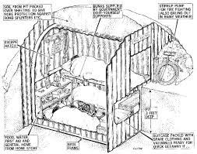
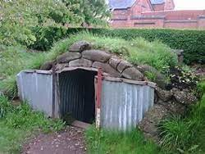
Anderson shelters
These shelters were half buried in the ground with earth heaped on top to protect them from bomb blasts.
They were made from six corrugated iron sheets bolted together at the top with steel plates at either end.
They measured 6ft 6in by 4ft 6in.
Over 2 million Anderson shelters were issued to households and cost £7 but were supplied free of charge to people earning less than £5 a week in danger areas.
During a air-raid a siren would sound to warn the area and people would leave their homes and take cover in their Anderson shelter.

Slide 15
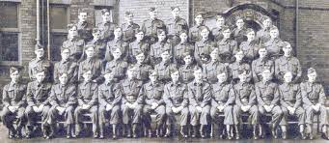
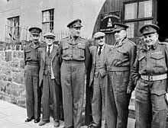
Home Guard
The Home Guard were volunteers who defended the five thousand miles of British coastline in the event of an invasion by Germany.
Individuals who were exempt from normal military service, maybe due to disability or age, could volunteer instead with the Home Guard.
At its peak it had 1.7 million members.
The Home Guard defended key targets such as factories, explosive stores, beaches and sea fronts. At night they patrolled fields in which enemy gliders or paratroopers might land.

Slide 16
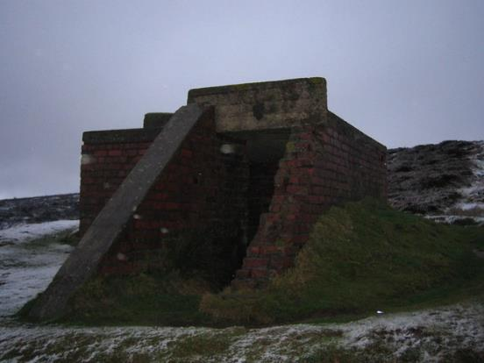
Starfish decoy sites
Starfish decoy sites were built to use light and fire to divert nighttime German bombers away from their intended targets. There was a starfish decoy site built on Guisborough Moor to protect industrial targets in Middlesbrough.
These decoys were large scale and were built to simulate a burning city. The aim was to divert the nighttime bombers from their intended targets so they would drop their bombs on the countryside.
The sites were controlled by bunkers and laid out to look like a fire bombed town.
By the end of the war there were 237 decoys protecting 81 towns and cities around the country.

Slide 17
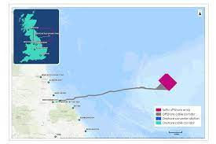
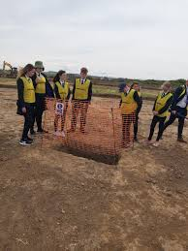
TOPIC QUESTION:
What are the causes and significant events of World War Two?
How was Teesside affected by WW2?
TOPIC QUESTION:
There is currently a project to build a wind farm off the coast of Redcar. Part of this project was to survey the land that is being affected (pipes running underground from the windfarm to the generator at Wilton).
In June 2021, an archeological survey in the farmers field next to Bydales found evidence of trenches. During World War One, Marske had an aerodrome and army barracks but what was found recently is from World War Two.
Although the army in World War Two did not fight in the trenches, like World War One, they were taught how to dig the trenches in a zig zag formation and some Historians have suggested that they used these practice trenches to practice dropping bombs. This is possibly what they did here in Marske.

Slide 18
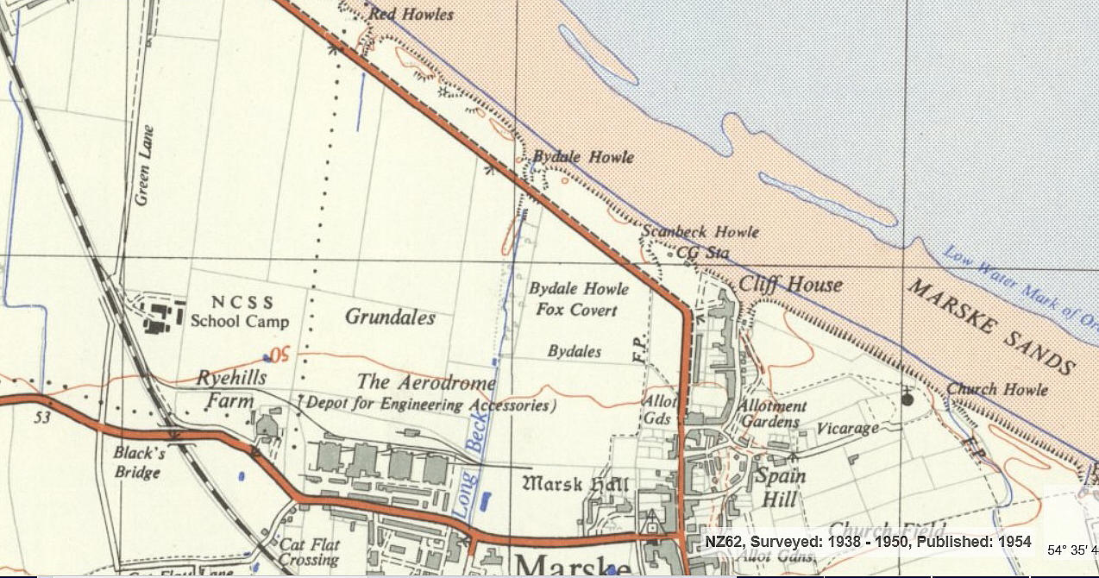

Slide 19
TOPIC QUESTION:
What are the causes and significant events of World War Two?
How was Teesside affected by WW2?
TOPIC QUESTION:
How was Teesside affected by World War Two?
What does the word affected mean? positive /negative.
How did the people of Teesside prepare for attack? Are we still affected today? Evidence of history around us?
Starter sentences
Teesside was affected by World War Two because…
The people of Teesside prepared for attack by…
Teesside is still affected by World War Two because…

