Slide 1
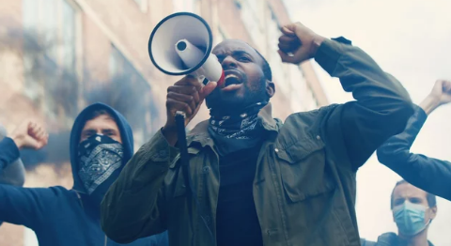
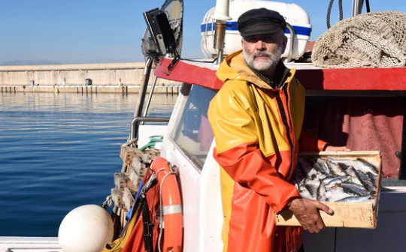
Is this how the Offshore Wind Plan will go?
Images © Adobe Stock Images

Slide 4
Images © Adobe Stock Images
Film documentary : each group is to prepare a short film report of the controversy
Reporter : presents the Dogger Bank wind farm plan
For Group : say why they’re in favour of the plan
Anti Group : say why they’re opposed to the plan.
Expert / For Group : describes the compromise solution
Reporter asks Anti Group if they’re happy with this.
Reporter : sums up where they go from here.
(groups also require a camera-operator)

Slide 5
Against Groups | Compromise Agreed | Cheapest solution | Most popular solution | Easiest to put into place | Most expensive solution | Least popular solution | Most difficult to put into place
Fishermen
Taxpayers Alliance
Drax power station
Industrial power users
Whale & dolphin conservation
Images © Adobe Stock Images

