Slide 1
5-MINUTE MEMORY CHALLENGE
TASK:
Geog your memory
Recall 3 facts you can remember about the Sofia wind farm.
Be Safe. Be Respectful. Be Responsible

Slide 2
5-MINUTE MEMORY CHALLENGE
TASK:
Geog your memory
Recall 3 facts you can remember about the Sofia wind farm.
Be Safe. Be Respectful. Be Responsible

Slide 3
LEARNING INTENTIONS:
TOPIC QUESTION:
How important is renewable energy to my local area?
LESSON QUESTION:
What jobs are linked to the Sofia wind farm?
Be Safe. Be Respectful. Be Responsible.

Slide 4
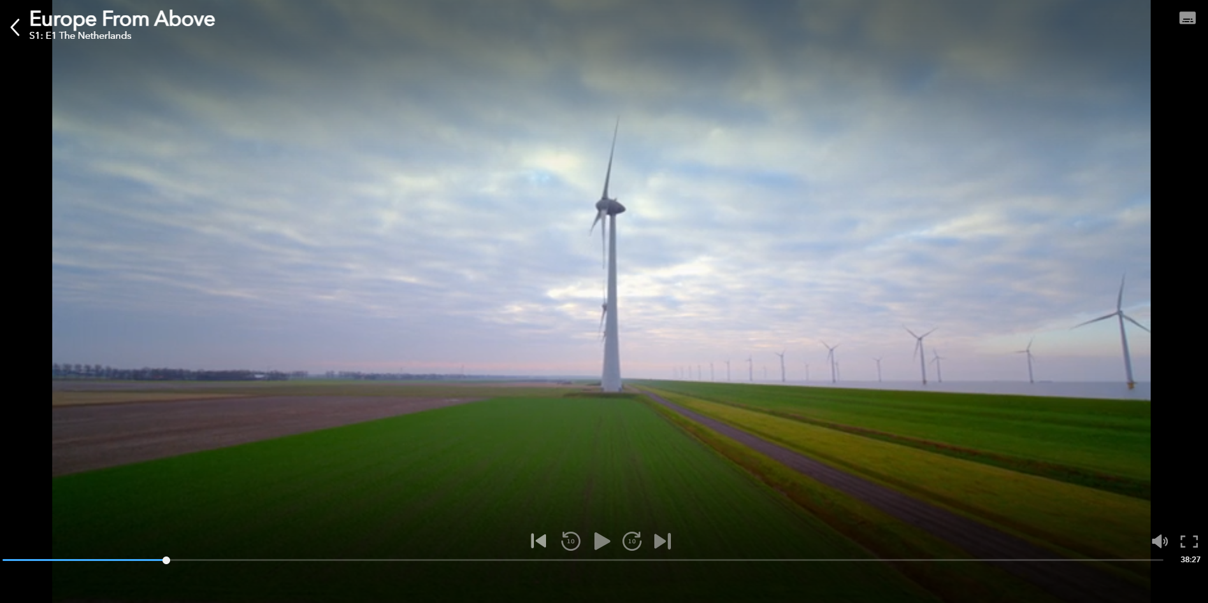
How important is renewable energy to my local area?
What jobs are linked to Sofia wind farm?
Watch the video clip very carefully.
We will see jobs linked to the creation of wind farms.
Questions
What is Patrick’s job?
What are the risks associated with this job?
Would you like to do this job?
What skills and attributes do you think Patrick needs to be successful in this job?

Slide 5
How important is renewable energy to my local area?
What jobs are linked to Sofia wind farm?
Careers in energy
Task: Match the job descriptions to the right person.
They are all jobs linked to renewable energy.
Stretch: What other jobs could be linked to wind energy?
List as many as you can.

Slide 7
How important is renewable energy to my local area?
What jobs are linked to Sofia wind farm?
In the wind energy sector, there are various job roles linked to different aspects of wind energy generation, including installation, maintenance, research, engineering, and project management.
Wind Turbine Technician:
Responsibilities:
Conduct routine maintenance and repairs on wind turbines.
Troubleshoot and diagnose mechanical, electrical, and hydraulic issues.
Perform inspections and ensure compliance with safety regulations.
Average Salary: The average salary for a Wind Turbine Technician can range from £31,463.20 to £47194.80 per year, depending on experience and location.
Wind Energy Engineer:
Responsibilities:
Design and develop wind energy systems and components.
Conduct feasibility studies for wind farm sites.
Perform simulations and analysis to optimize wind turbine performance.
Average Salary: The average salary for a Wind Energy Engineer can range from £55,000 to £80,000 per year, depending on experience and location.

Slide 8
How important is renewable energy to my local area?
What jobs are linked to Sofia wind farm?
In the wind energy sector, there are various job roles linked to different aspects of wind energy generation, including installation, maintenance, research, engineering, and project management.
Wind Farm Project Manager:
Responsibilities:
Plan and coordinate the development and construction of wind farm projects.
Manage project budgets, timelines, and resources.
Oversee permitting, procurement, and stakeholder engagement.
Average Salary: The average salary for a Wind Farm Project Manager can range from £62,000 to £95,000 per year, depending on experience and project size.
Wind Energy Sales Representative:
Responsibilities:
Promote and sell wind energy systems to potential clients.
Provide product information, negotiate contracts, and manage customer relationships.
Stay updated on industry trends and market developments.
Average Salary: The average salary for a Wind Energy Sales Representative can range from £40,000 to £62,000 per year, depending on experience and sales performance.

Slide 9
How important is renewable energy to my local area?
What jobs are linked to Sofia wind farm?
Living and working at sea: what’s it like to work on a Service Operations Vessel?
Task: Create a diary entry..life on a service operations vessel.
Dear Diary…
We arrived on deck this morning…
My living quarters are …
My main responsibilities are….
I work… weeks on ship and have…off
The thing I love most about my job are…
The most difficult part of my job is…

Slide 10
How important is renewable energy to my local area?
What jobs are linked to Sofia wind farm?
Plenary
‘I would be interested in a career in wind energy in the future’
YES! Careers in the wind energy sector interest me because…
NO! A career in wind energy is not for me because…

